Slide 1
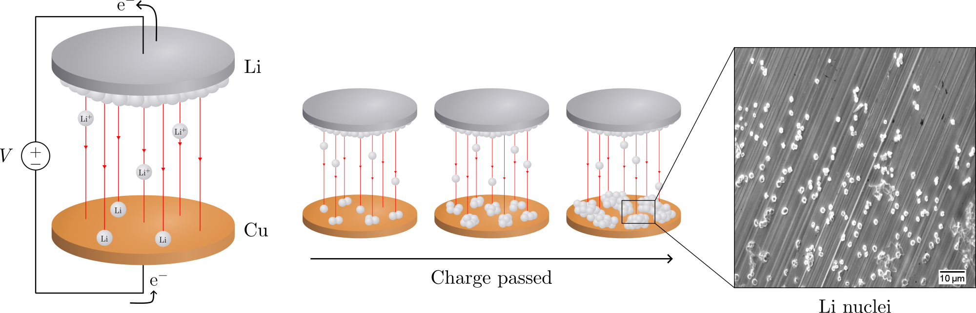
Electrochemical deposition of lithium on copper
Gottfrid Olsson
2024-05-29

Slide 2
PLAN: 25 minute presentation
Introduction:
Importance of batteries, improvements LMB>LIB (fig.), problems non-uniform growth (fig + in-depth), purpose of this thesis
Theory:
Homogenous nucleation theory; main results (fig.), how does eta impact r and N (fig.)?
Methods:
Cell assemblies (note importances; wave spring, no pressure); cycling protocol (fig.)
Results:
passivation of Cu; J-dep.; pressure (C-cell and T-cell, r & angle dep. and morphology)
Conclusion: 2 min
Passivation, J-dep. and pressure to achieve uniform deposition in LMBs
(Opposition and Questions from audience)

Slide 3
Introduction
Batteries
Lithium-ion battery very common type; you probably have it!
Lighter and smaller by replacing graphite in LIB with Li-metal

Slide 4
Batteries!
Opening: How many here have either a smartphone, a laptop, or a smartwatch?
Cool, then you are already fans of batteries, and you likely own at least one lithium-ion battery – a very common battery type
Say, would you like your device to be smaller, lighter, and have a longer battery life? Of course you would!
It’s easy, look: replace this graphite with Li and the cell increases its energy per weight and doubles the energy per volume – very nice!
A) Let’s use this battery. Oh… what’s happening? Without the graphite, Li gets deposited on the surface. The Li grows unevenly, and oh no – look – it reached the other side of the cell! It’s a short-circuit, and [thermal runaway] *BOOM* [cell explosion] Yikes. Not good. Uneven deposition seems to be a problem.
B) However, there are several problems with such a lithium-metal battery.
//Kanske börja lite roligare som “opening:” beskriver, men sen ta (B) istället för (A).

Slide 5
Batteries!
250 Wh kg^{–1} to 440 Wh kg^{–1}
600 Wh L^{–1} to 1200 Wh L^{–1}
//LIB one of the most used batteries today
Looks like this.
If replace graphite with Li, increase specific energy and double the energy density
Would benefit e.g. electrical vehicles (extra range)
However, problems bcs. Li depos on surface! (n.s.)

Slide 6
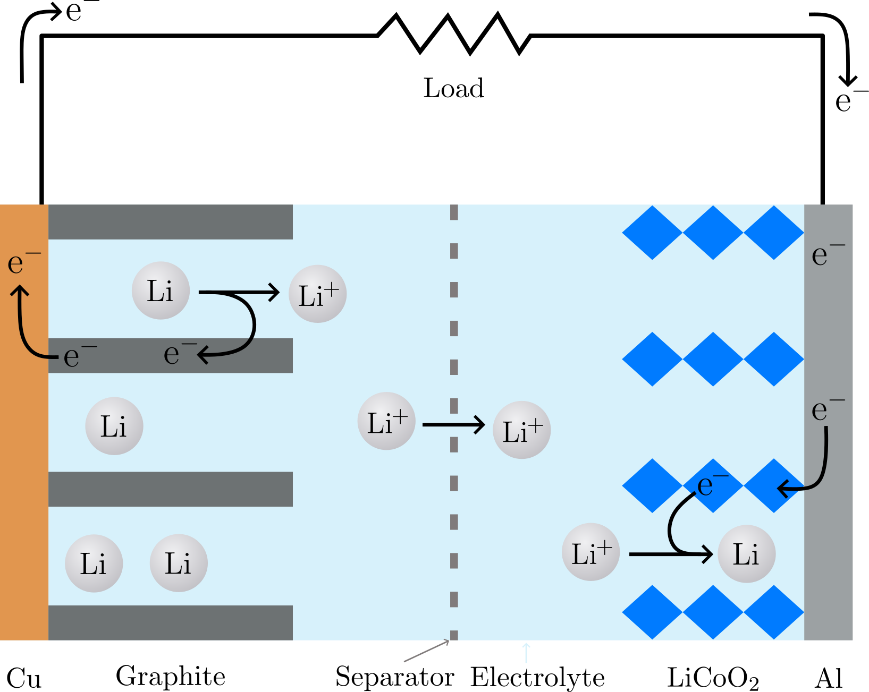
Batteries!

Slide 7
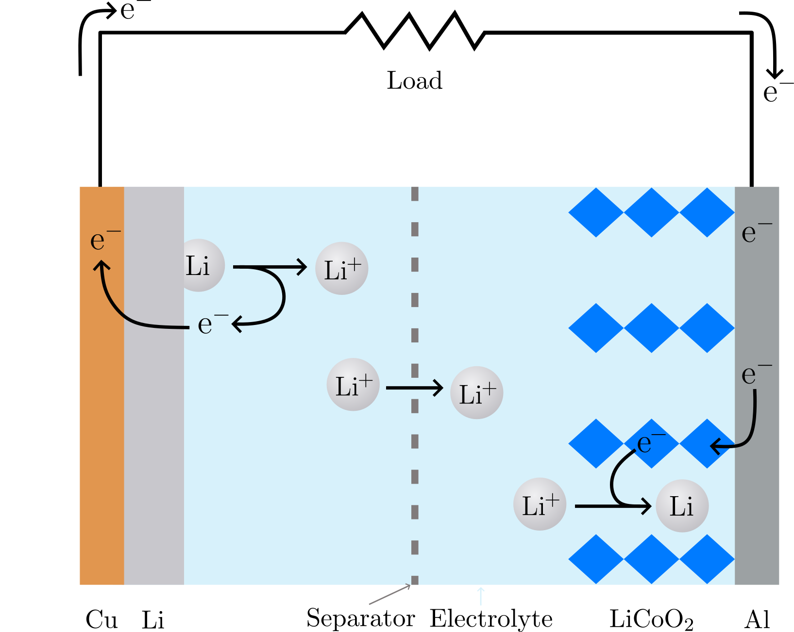
Batteries!

Slide 8
Batteries! Ev istället bilder:

Slide 9
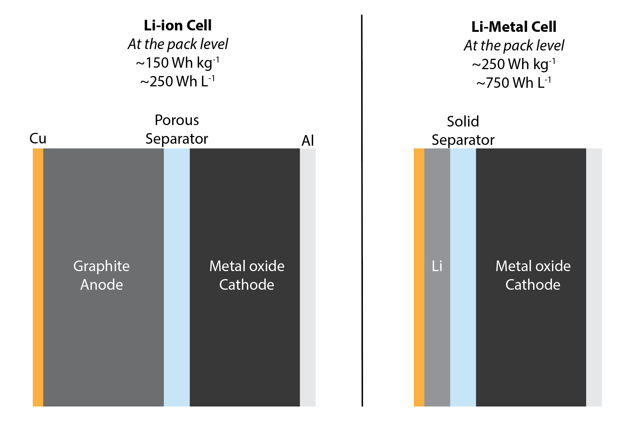
Batteries!
Jmf LIB (cell) med LMB (cell), ignore values written in the figure
Isf. Ändra färg I nästa slides non-uniform deposition problems.
(http://large.stanford.edu/courses/2020/ph240/kim1/)

Slide 10
Batteries!

Slide 11
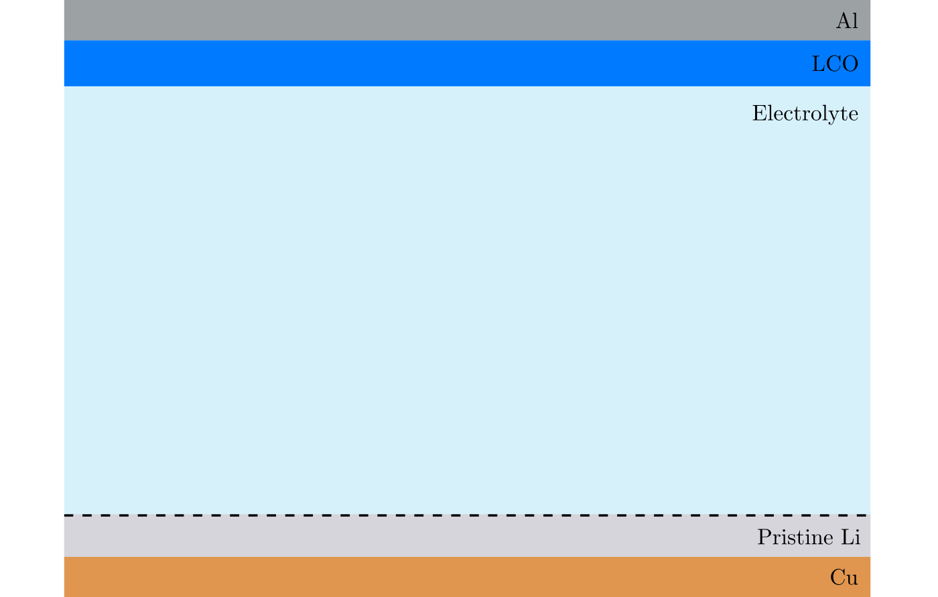
Non-uniform deposition problems

Slide 12
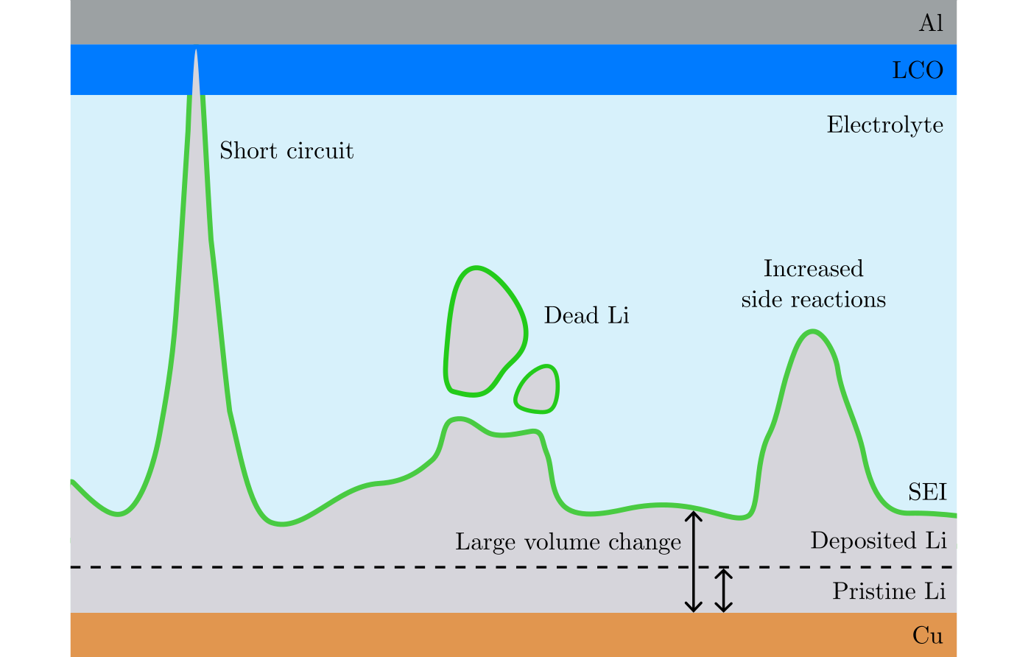
Non-uniform deposition problems

Slide 13
Purpose of this thesis
To avoid non-uniform deposition, the first step in deposition of Li – nucleation, must be well understood.
Purpose: investigate how pressure, current, and passivation influences the nucleation. Bcs knowledge about this leads to ways of inducing uniform deposition.
Scanning electron microscopy (SEM) and electrochemical cycling.

Slide 14
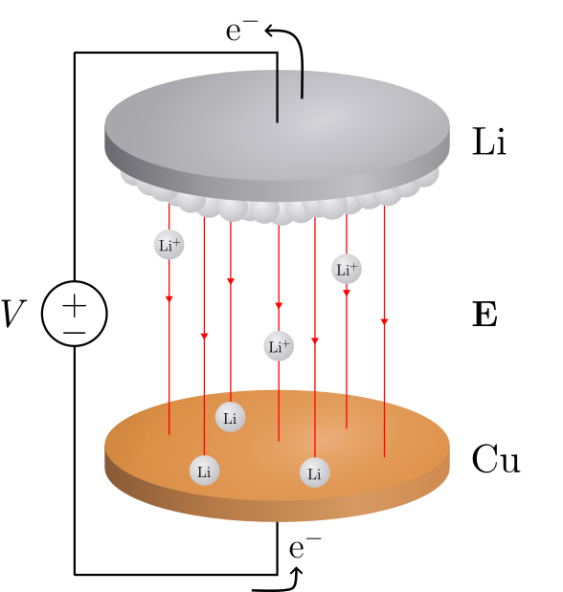
Deposition in a Li/Cu cell
Notes:
Here is a schematic of a Li/Cu cell.
Voltage difference → electrical fields → force on positive charges, Li+.
Electrons released and then recombines with the Li.

Slide 15
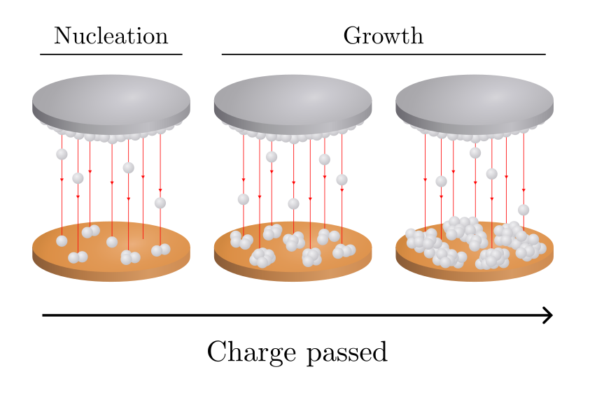
Deposition in a Li/Cu cell
Notes:
As more charge is passed (measure current, the electrons), more and more Li is deposited.

Slide 16
Deposition in a Li/Cu cell
Notes:
We identify two stages: nucleation and growth.
Nucleation is the first part and the focus of this thesis.

Slide 17
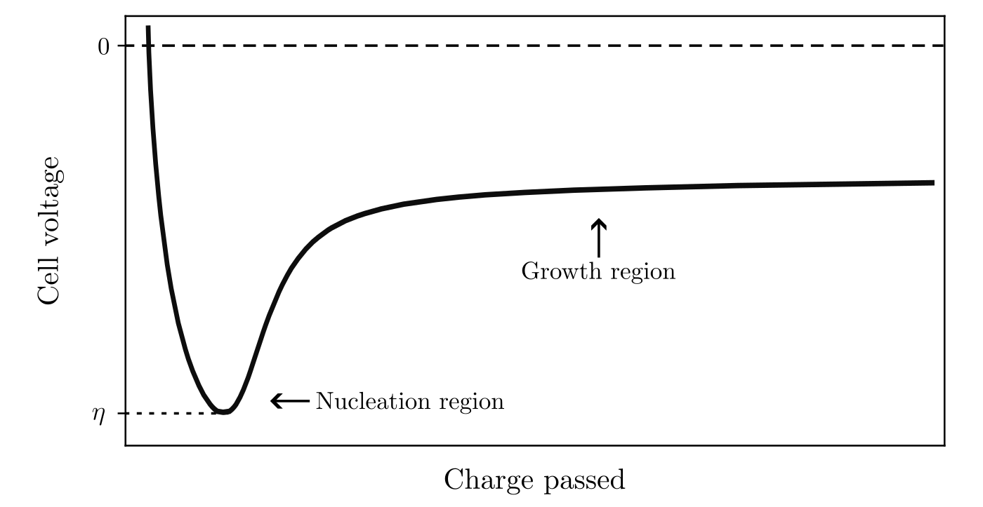
Deposition in a Li/Cu cell
Notes:
Let’s look at how the cell voltage varies with charge passed during deposition.

Slide 18
Deposition in a Li/Cu cell
Notes:
There is first a sharp drop in potential, reaching a lowest value of eta – this we will call the overpotential of nucleation.
At this point of the curve, nucleation occurs.

Slide 19
Deposition in a Li/Cu cell
Notes:
Then, the voltage goes up and the nuclei grow.

Slide 20
Deposition in a Li/Cu cell
Notes:
And they continue to grow as more charge get passed.
So, the focus is on the nucleation part.
What is nucleation?

Slide 21
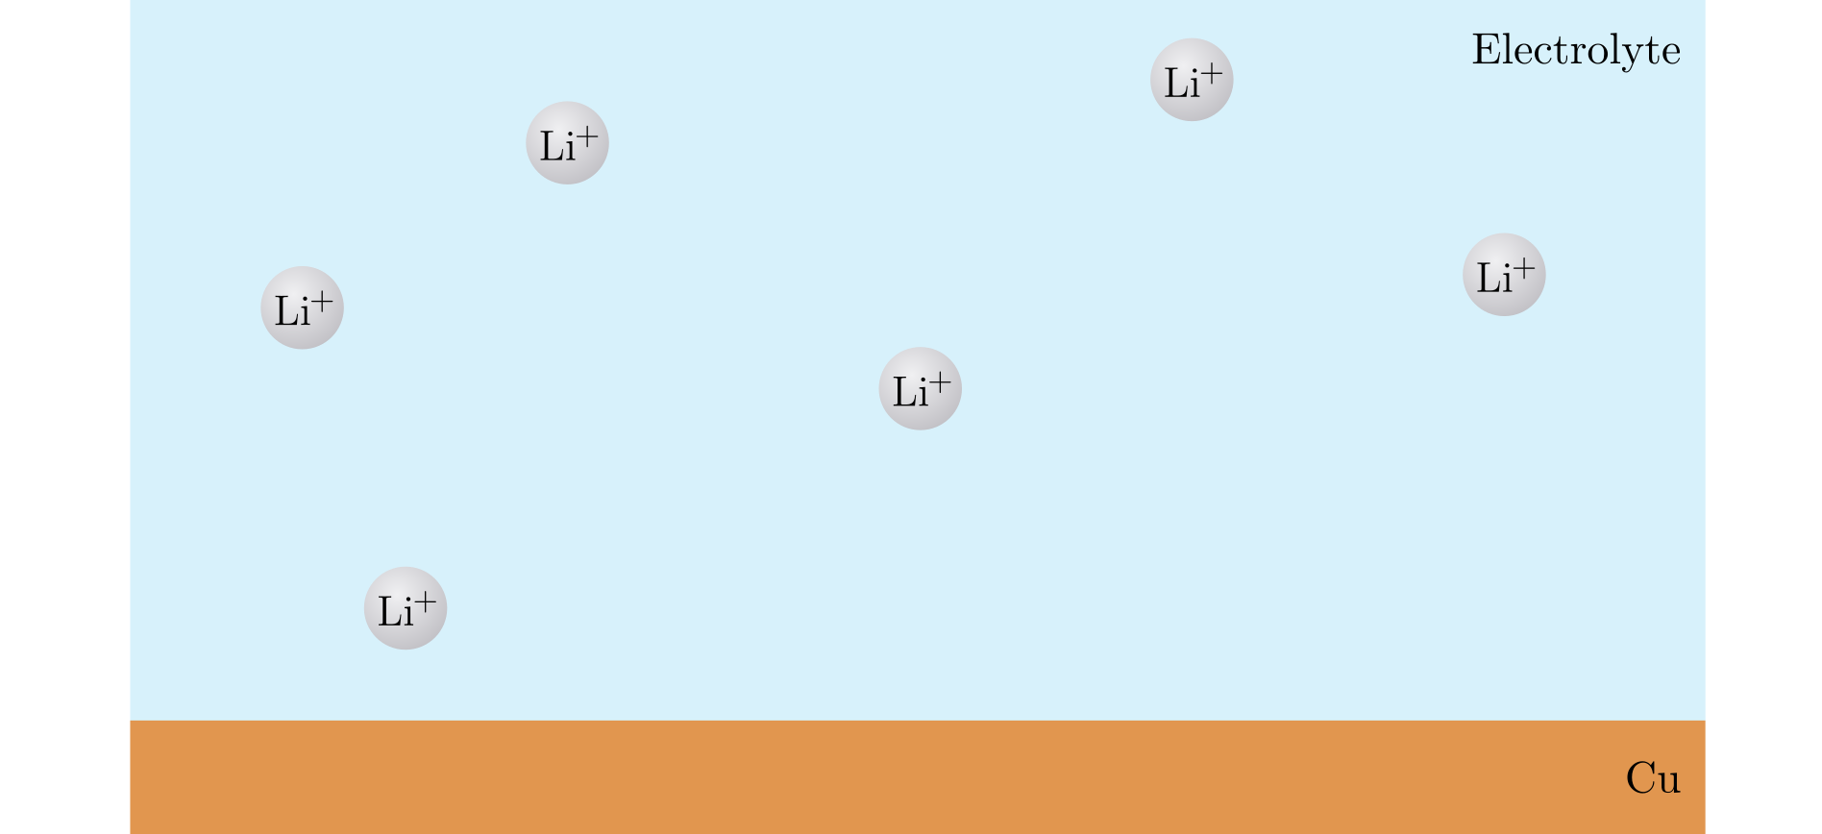
Nucleation
Notes:
Nucleation is the first step in forming a new phase within a substance.
In our case, imagine Li-ions in a solution.
They are liquid.

Slide 22
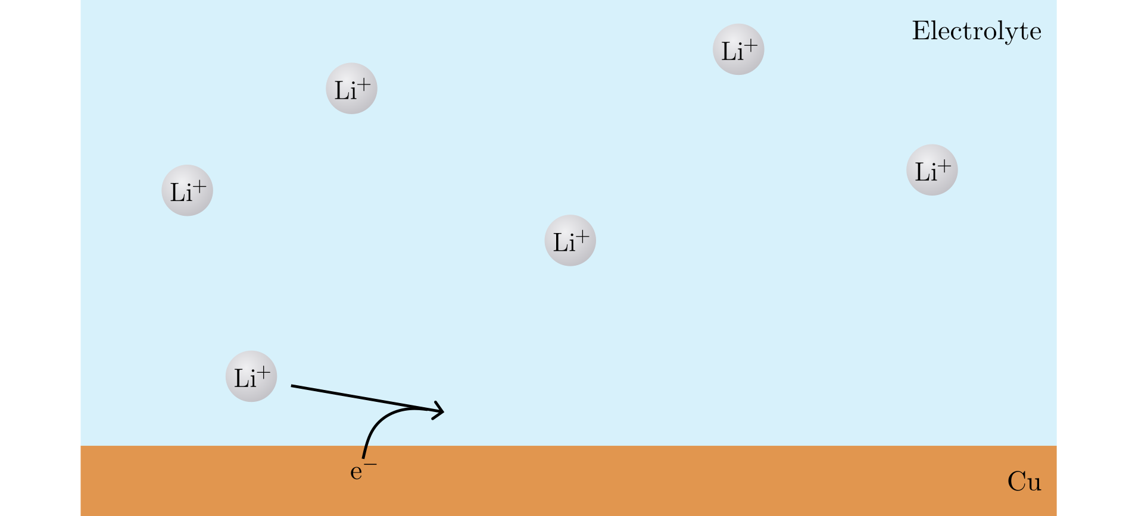
Nucleation
Notes:
A Li+ ion can take up an electron and …

Slide 23
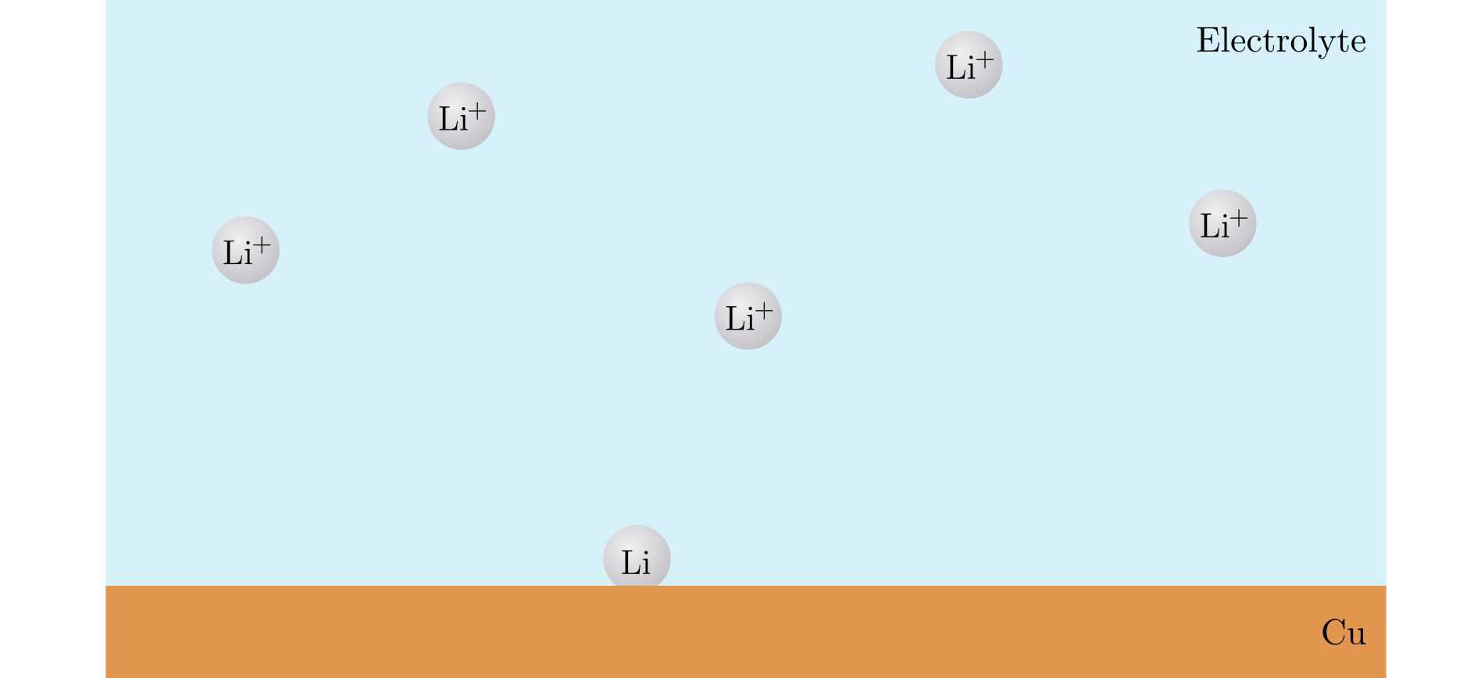
Nucleation
Notes:
Become a Li atom on the Cu surface.

Slide 24
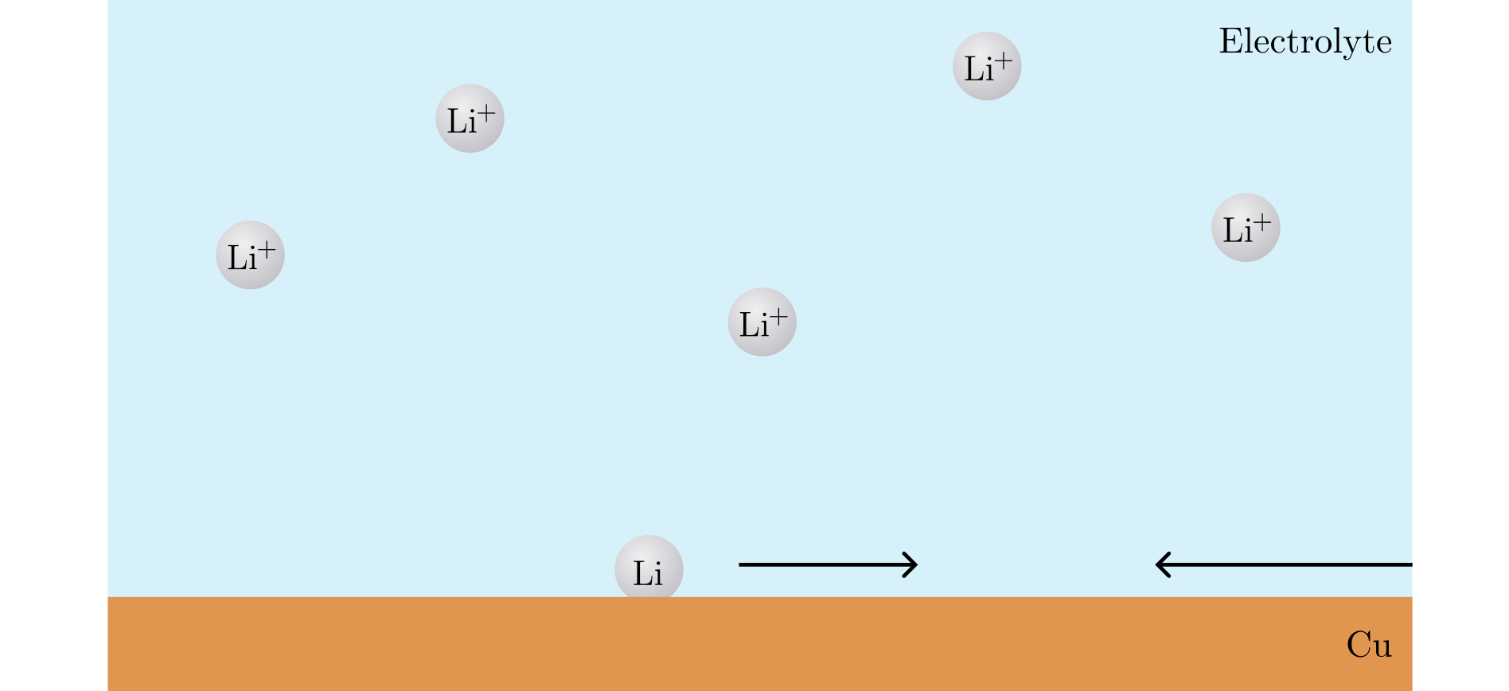
Nucleation
Notes:
If several Li atoms come together …

Slide 25
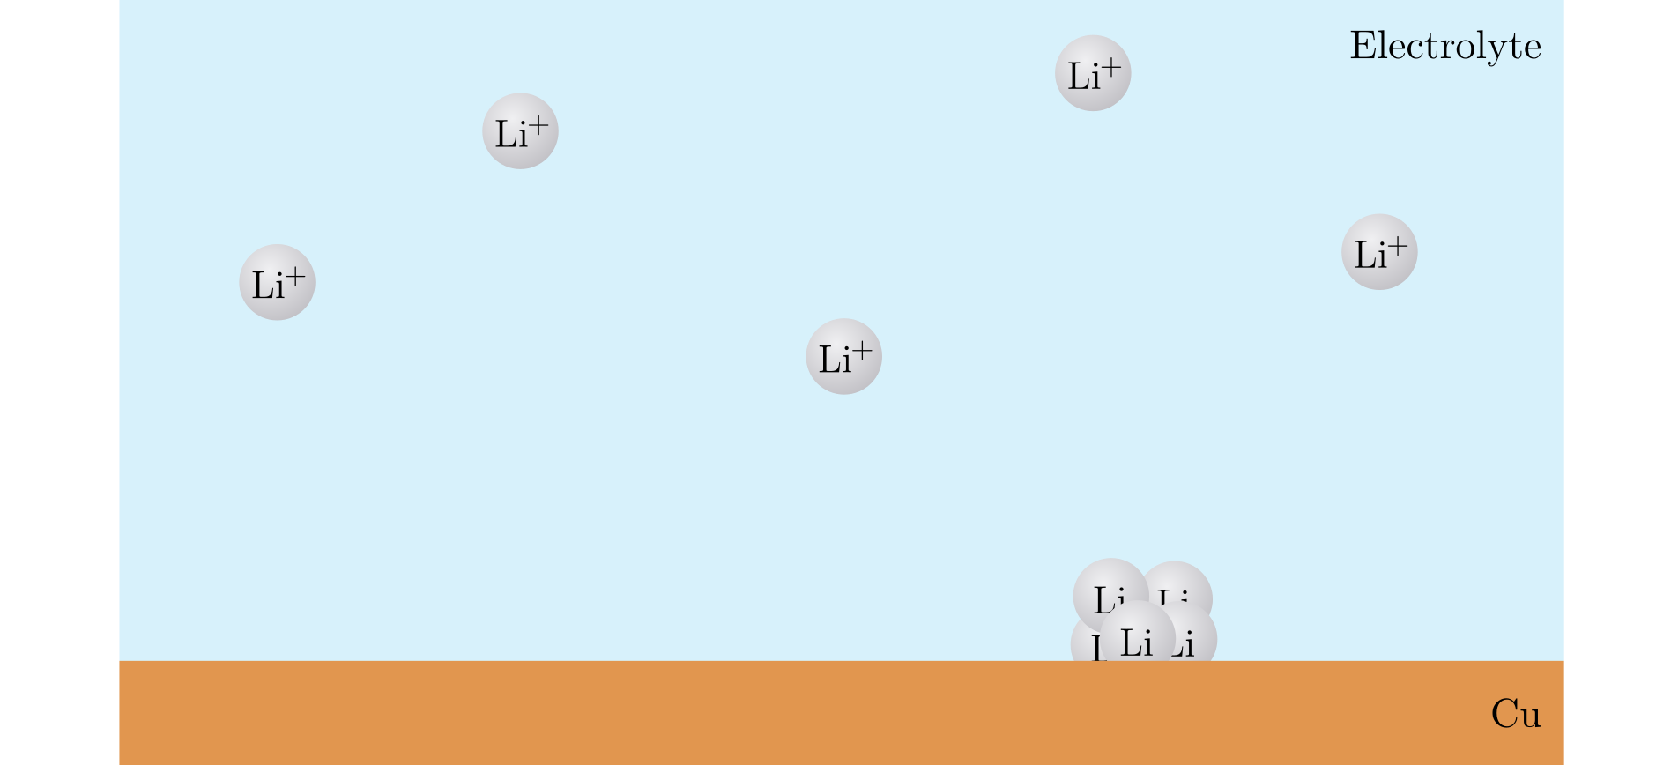
Nucleation
Notes:
A small cluster is formed.

Slide 26
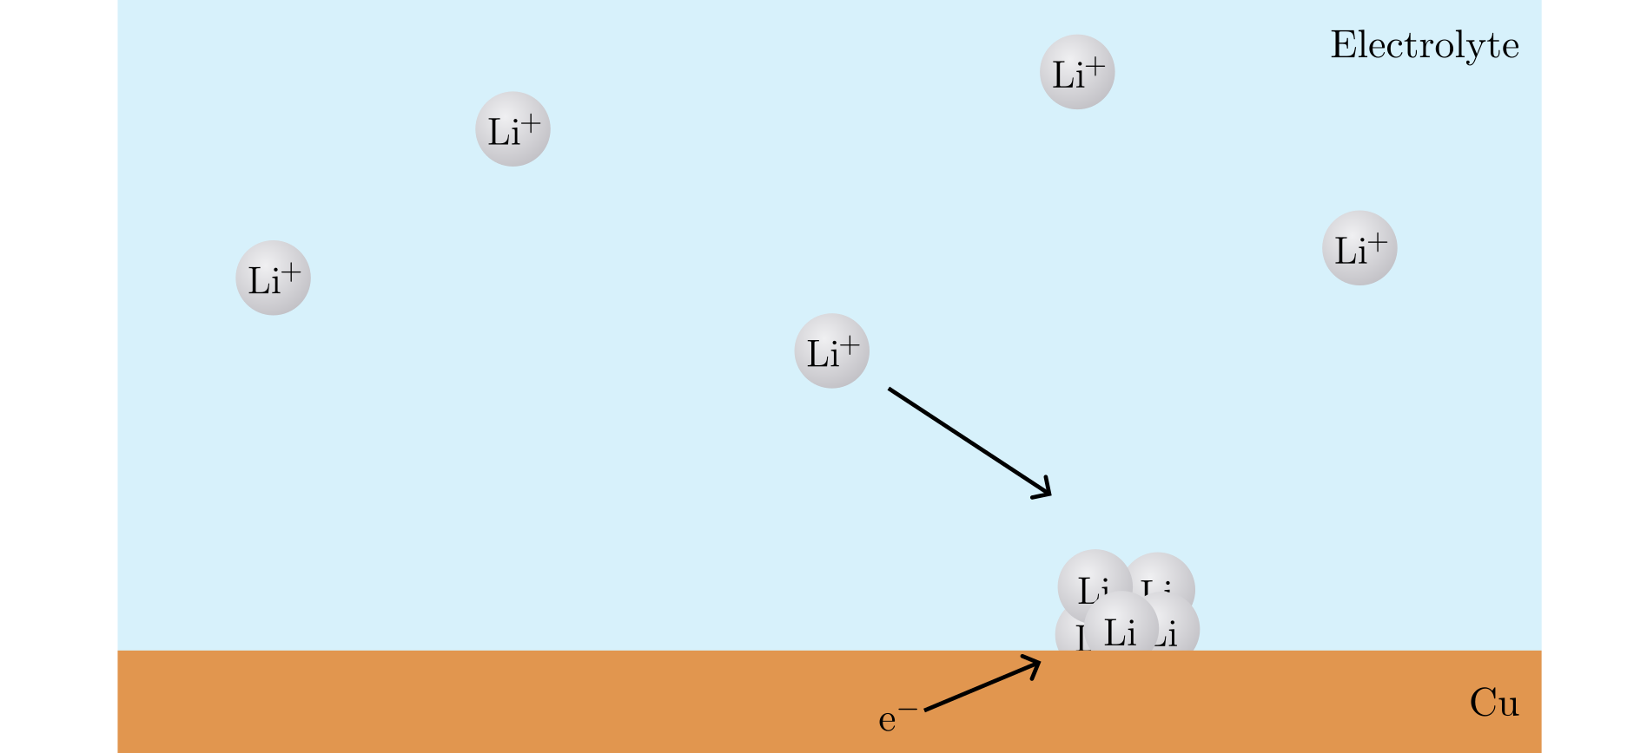
Nucleation
Notes:
As more Li+ ions get reduced and adsorbs to the cluster…

Slide 27
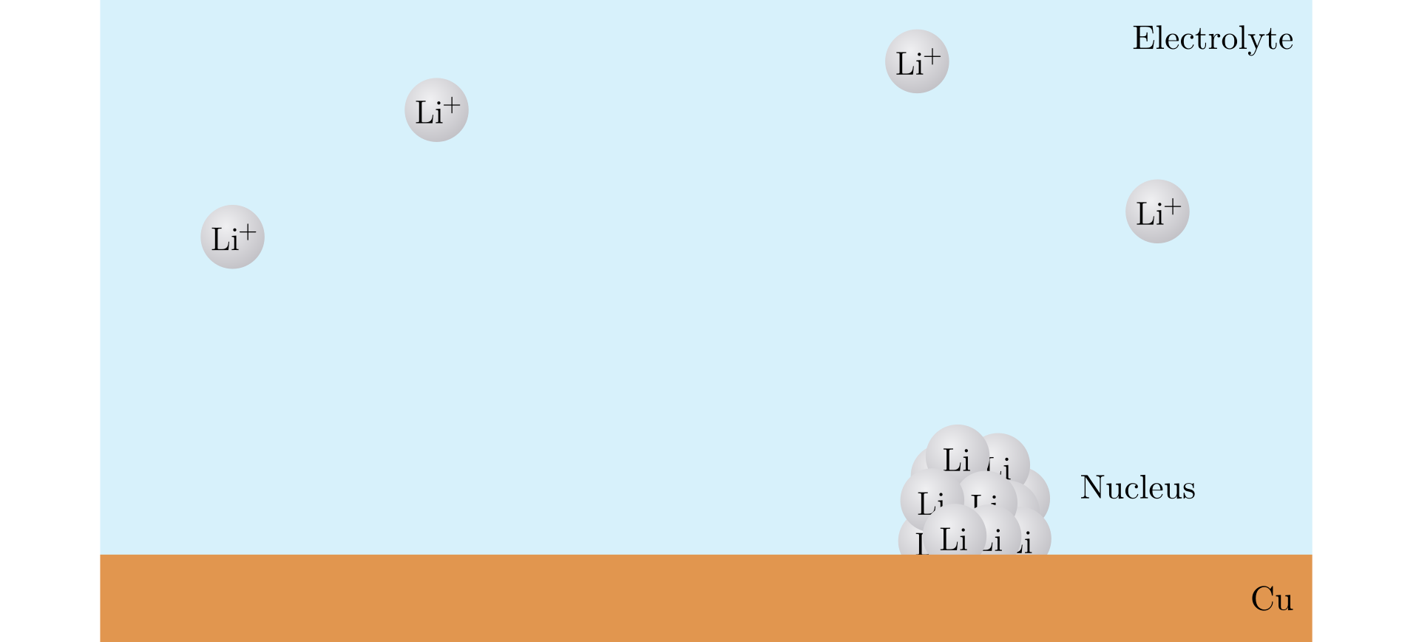
Nucleation
Notes:
This sequence, the formation of the new SOLID phase from the LIQUID, is called nucleation.
And the Li forms a nucleus, or several nuclei.

Slide 28
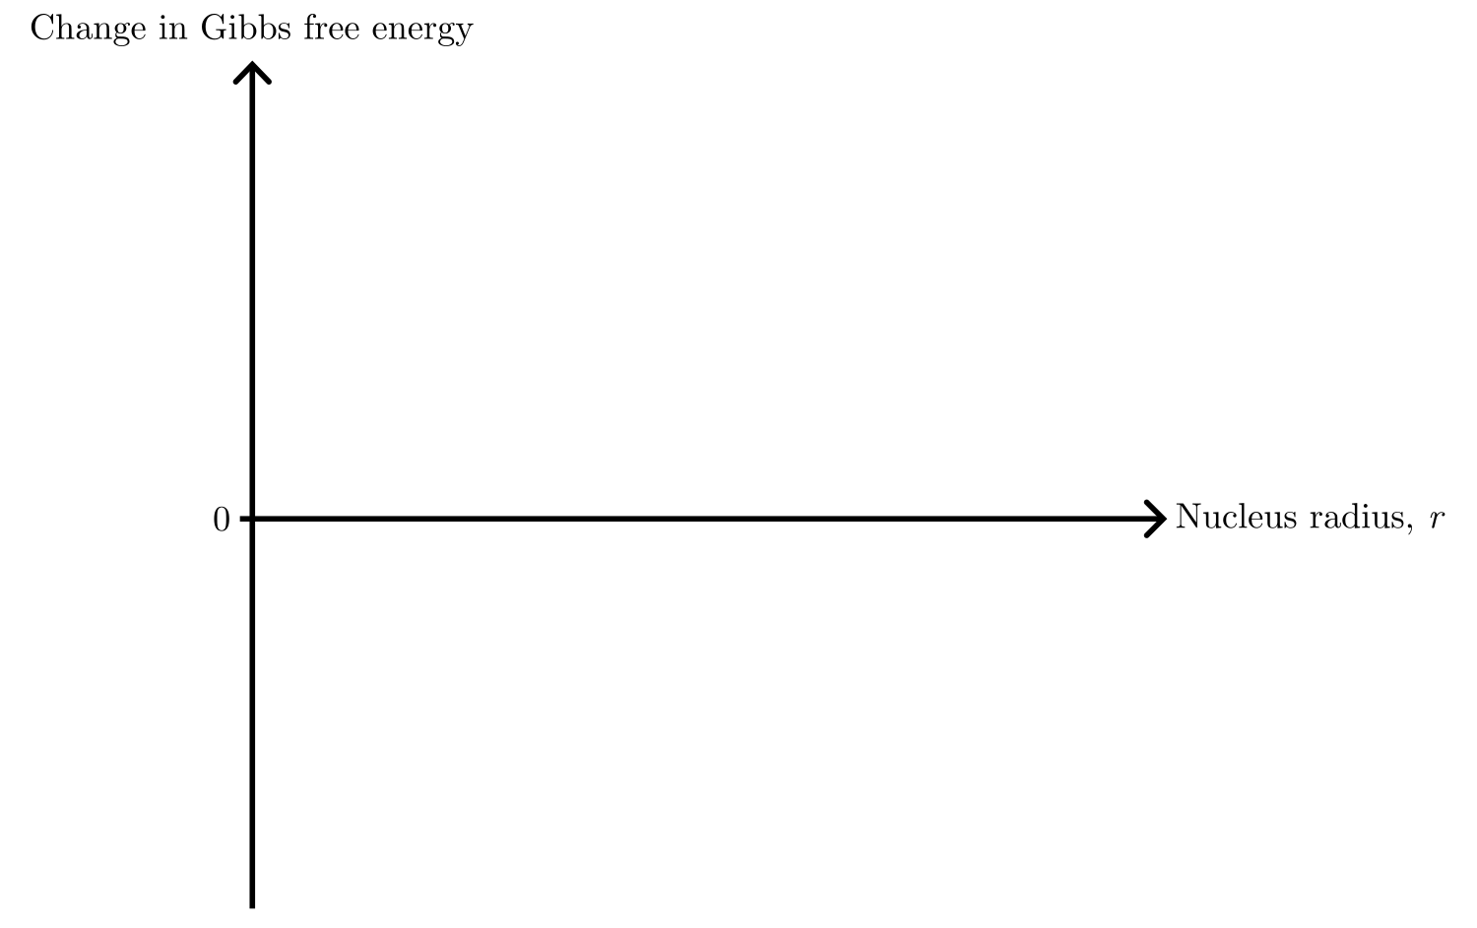
Nucleation theory
Notes:
A theoretical model of nucleation is done by looking at the change in Gibbs free energy as function of radius (assuming a spherical nucleus).

Slide 29
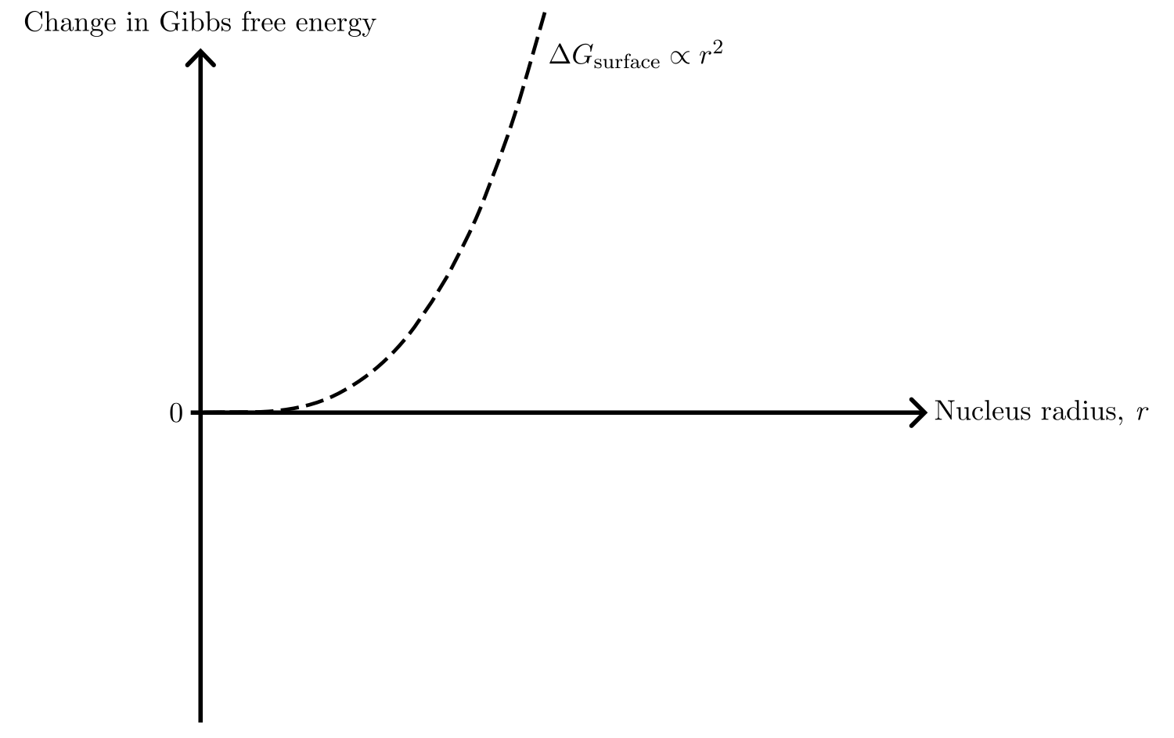
Nucleation theory
Notes:
To form the new phase, there is a cost for creating surface area.
It grows as r-squared.

Slide 30
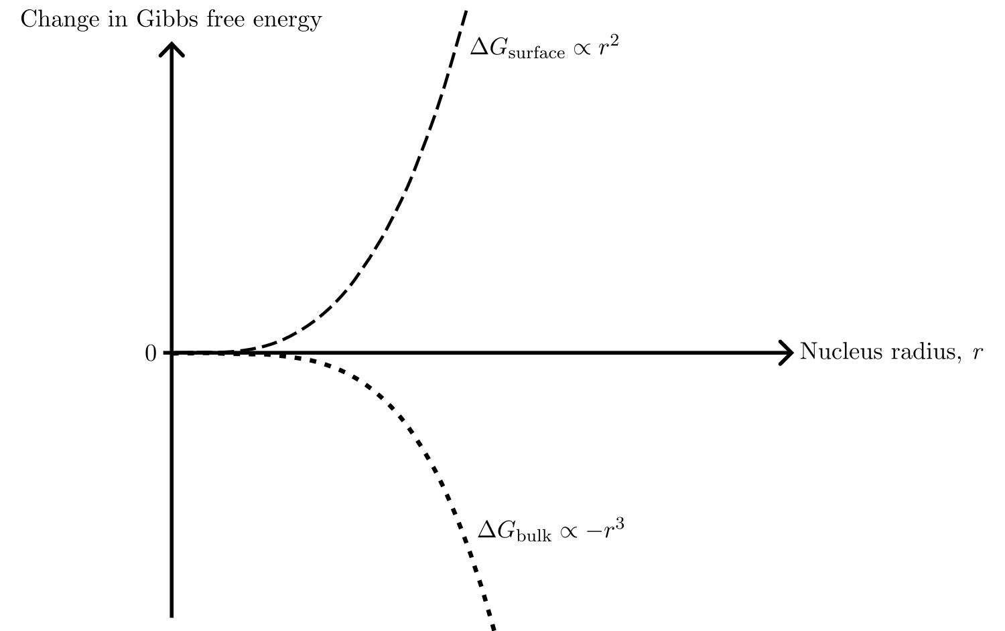
Nucleation theory
Notes:
At the same time, there is a gain in energy from creating bulk. Scaling as minus r-cubed.

Slide 31
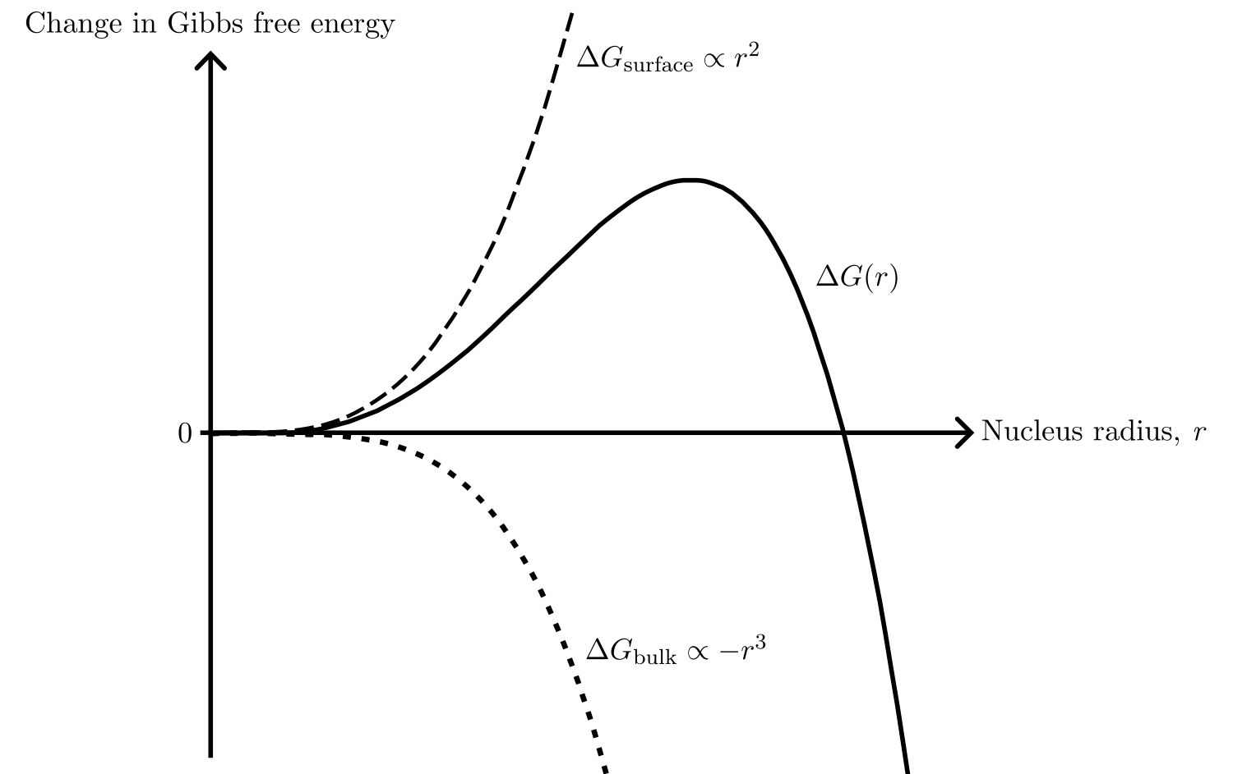
Nucleation theory
Notes:
The sum of these, DeltaG, is the change in Gibs free energy for creating a nucleus of radius r.
It costs energy to build a nucleus, up until this point…

Slide 32
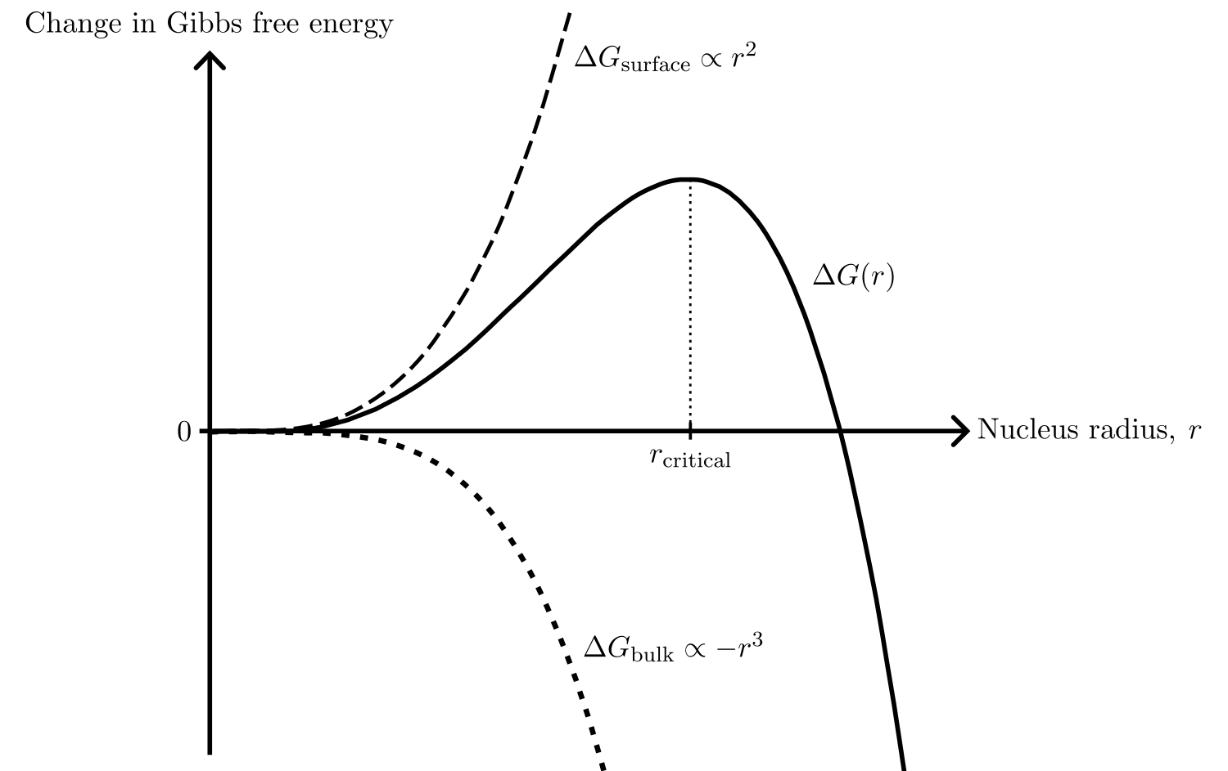
Nucleation theory
Notes:
This is the critical radius, where the nucleus start to grow spontaneously as this lowers the overall energy of the system.
But to get to that point, there is an energy barrier …

Slide 33
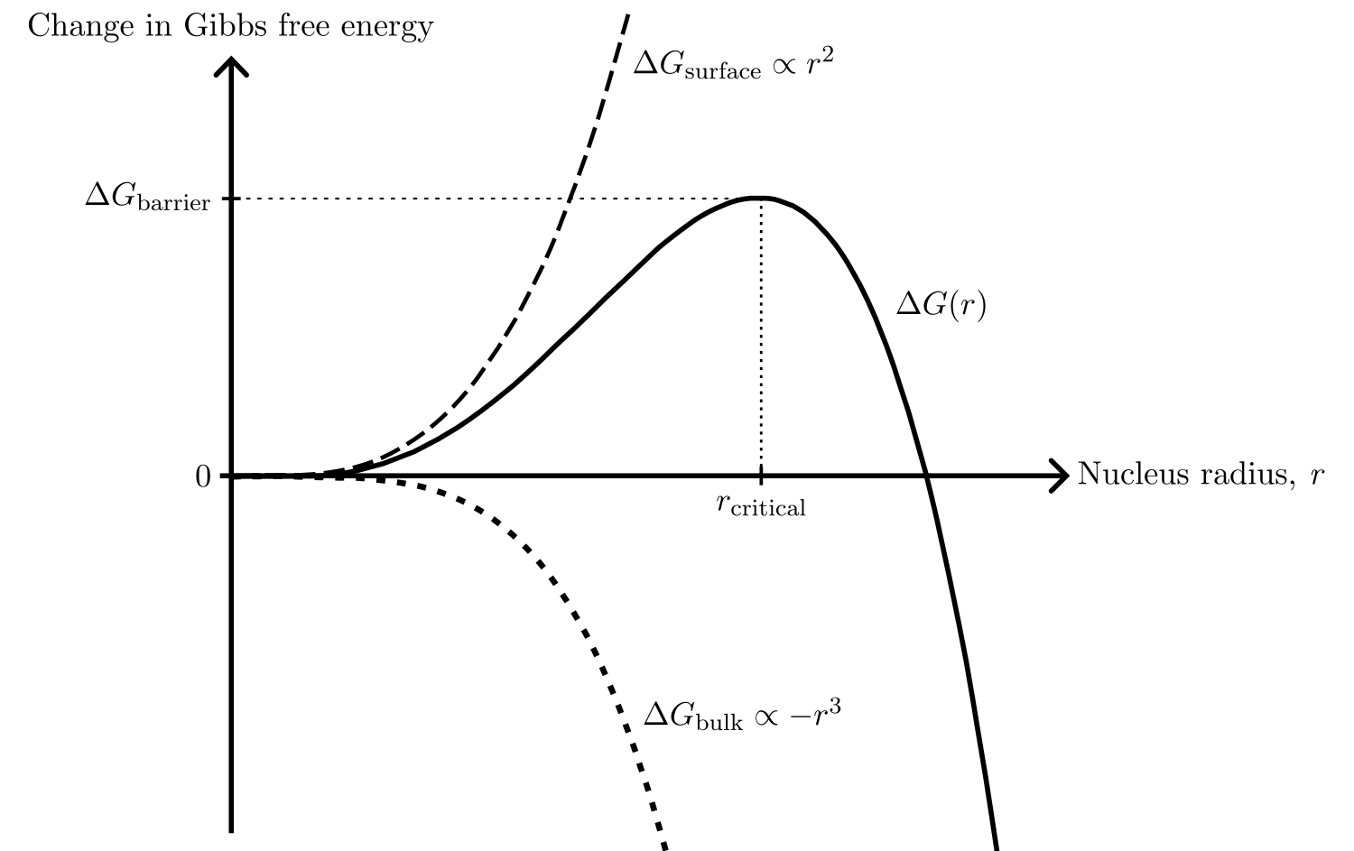
Nucleation theory
Notes:
Delta G_barrier, which needs to be overcome.

Slide 34
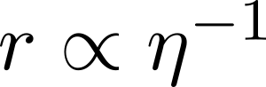
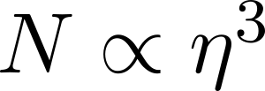
Nucleation theory
Notes:
Writing out the expression for DeltaG, one can show that the size of the nucleus r is inversely proportional to the overpotential eta, and that the number of nuclei per area N is proportional to the third power of the overpotential.

Slide 35
Nucleation theory
Notes:
Let’s see schematically what this means.

Slide 36
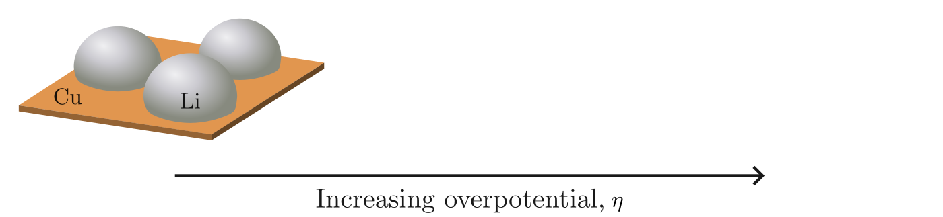
Nucleation theory
Notes:
For low overpotential: large and few nuclei.

Slide 37
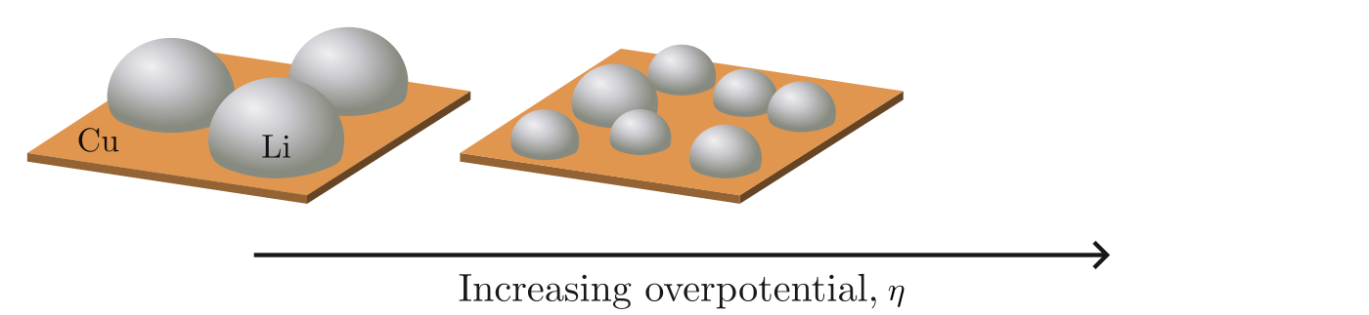
Nucleation theory
Notes:
Increasing overpotential: smaller and more nuclei.

Slide 38
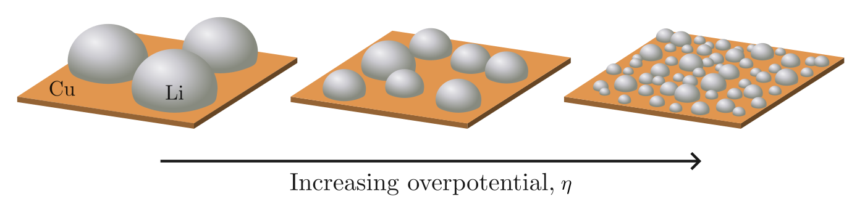
Nucleation theory
Notes:
Increasing overpotential: smaller and more nuclei.
In this way, the overpotential influences the nuclei distribution (size and nuclei per area).

Slide 39
Specific scientific questions
The shape of the deposition curve
Degree of passivation of the Cu surface
Deposition current
Distribution of the nuclei
Pressure distribution between the Li and Cu
Notes:
Now, this thesis will focus on how the shape of the deposition curve, and how the distribution of the nuclei can be affected.

Slide 40
Specific scientific questions
The shape of the deposition curve
Degree of passivation of the Cu surface
Deposition current
Distribution of the nuclei
Pressure distribution between the Li and Cu
Notes:
The shape will be investigated by looking at the degree of passivation of the Cu surface, and the current during deposition.

Slide 41
Specific scientific questions
The shape of the deposition curve
Degree of passivation of the Cu surface
Deposition current
Distribution of the nuclei
Pressure distribution between the Li and Cu
Notes:
We will look at how the pressure affects the distribution of the nuclei.
The methods chosen are:
Electrochemical cycling (the deposition curve shown before)
Scanning electron microscope to image the Li nuclei
To have different pressures, we need different cell setups.

Slide 42
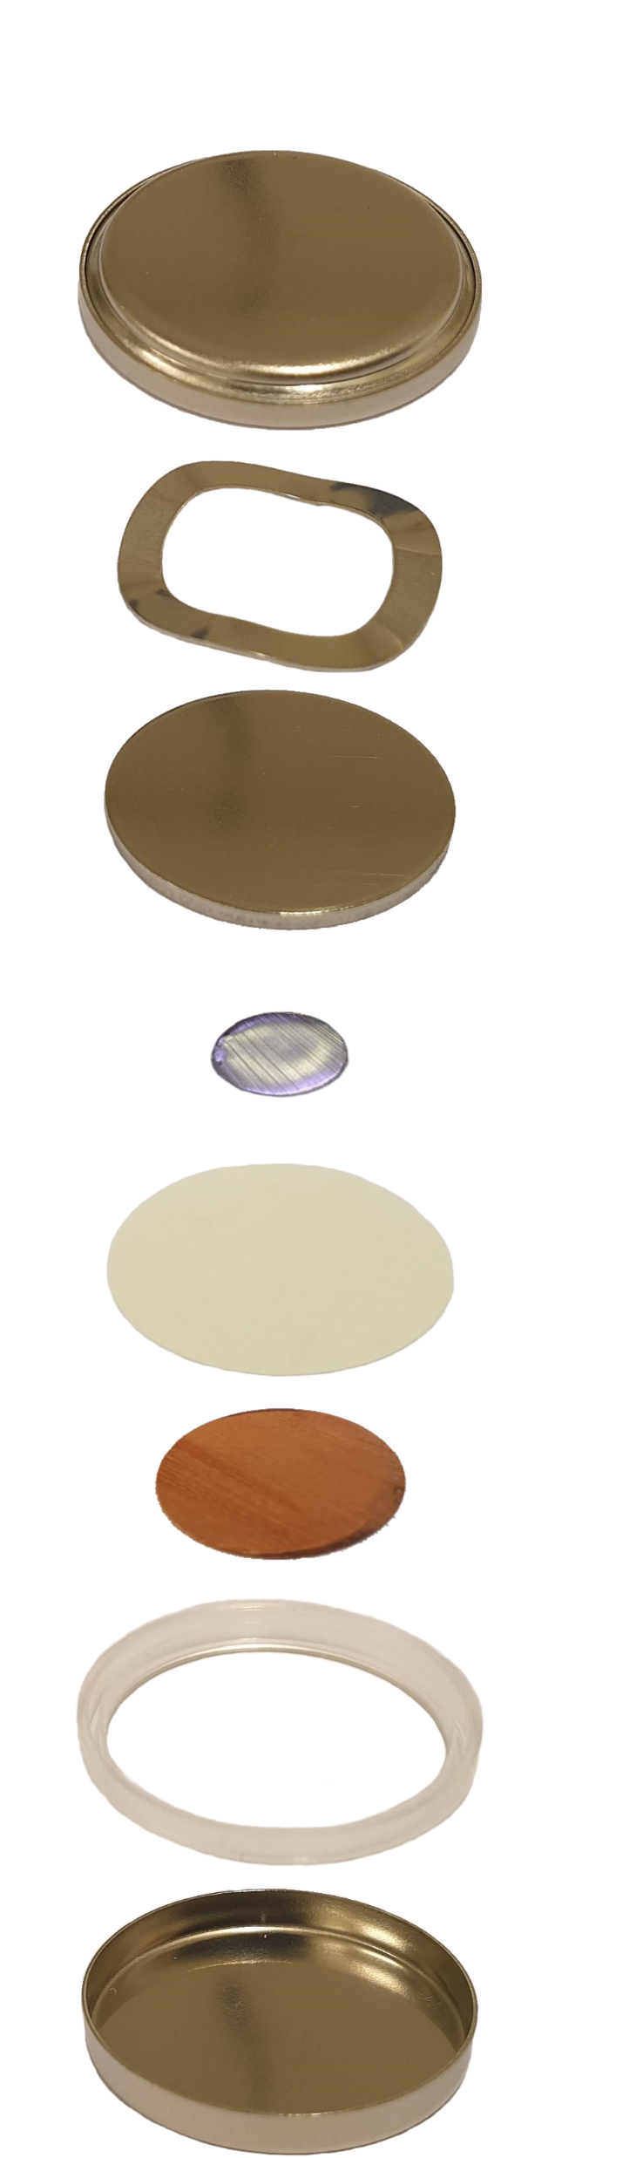
The C-cell
Cap
Spring
Spacer
Li
Separator
Cu
Gasket
Can
Notes:
First the coin cell, or C-cell.
The parts, add electrolyte to the separator and push them together …

Slide 43
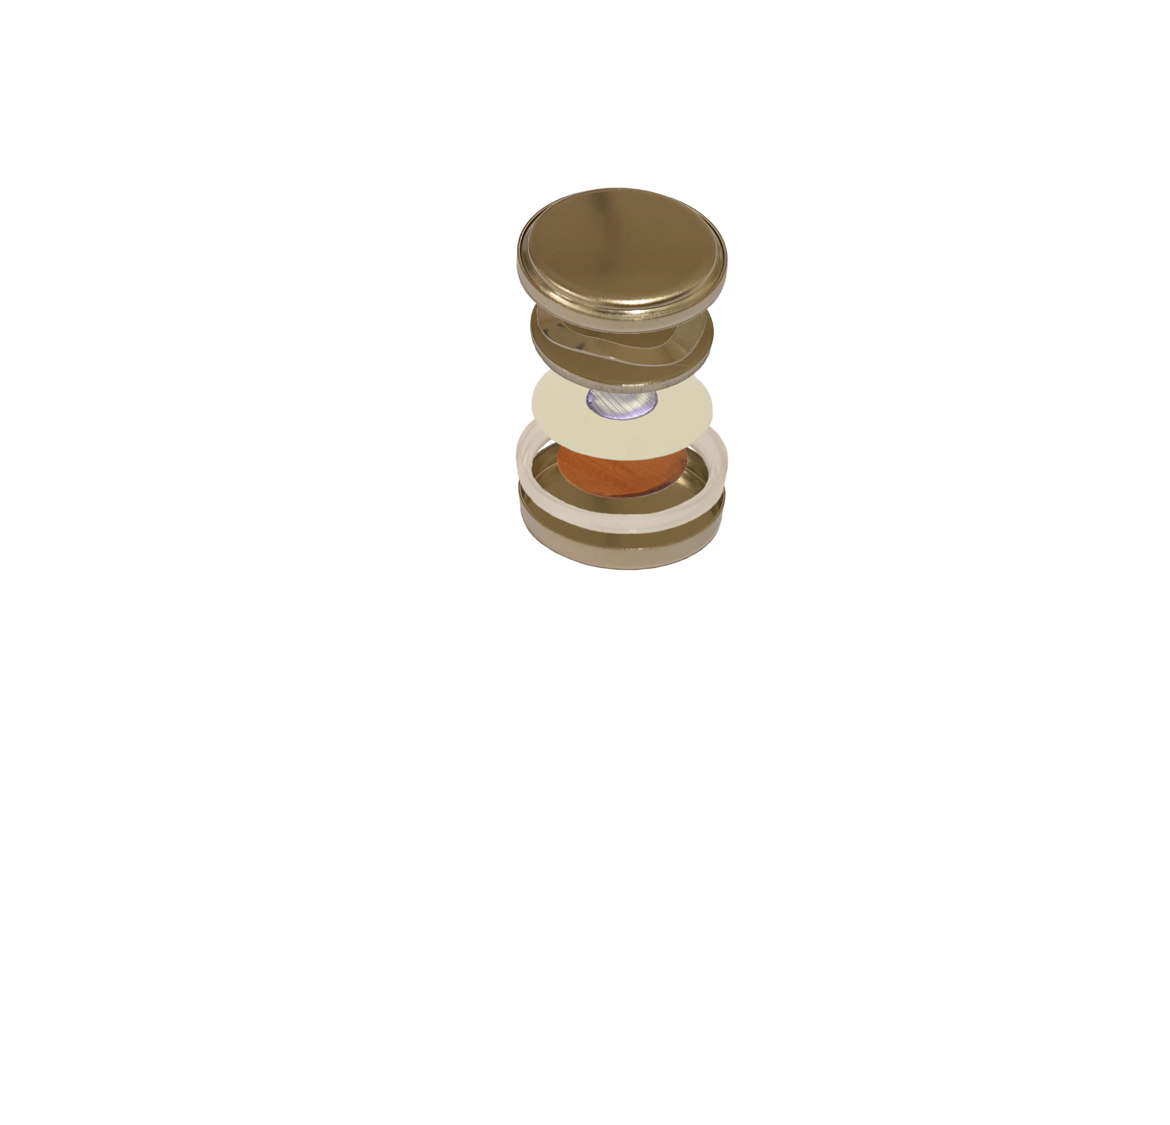
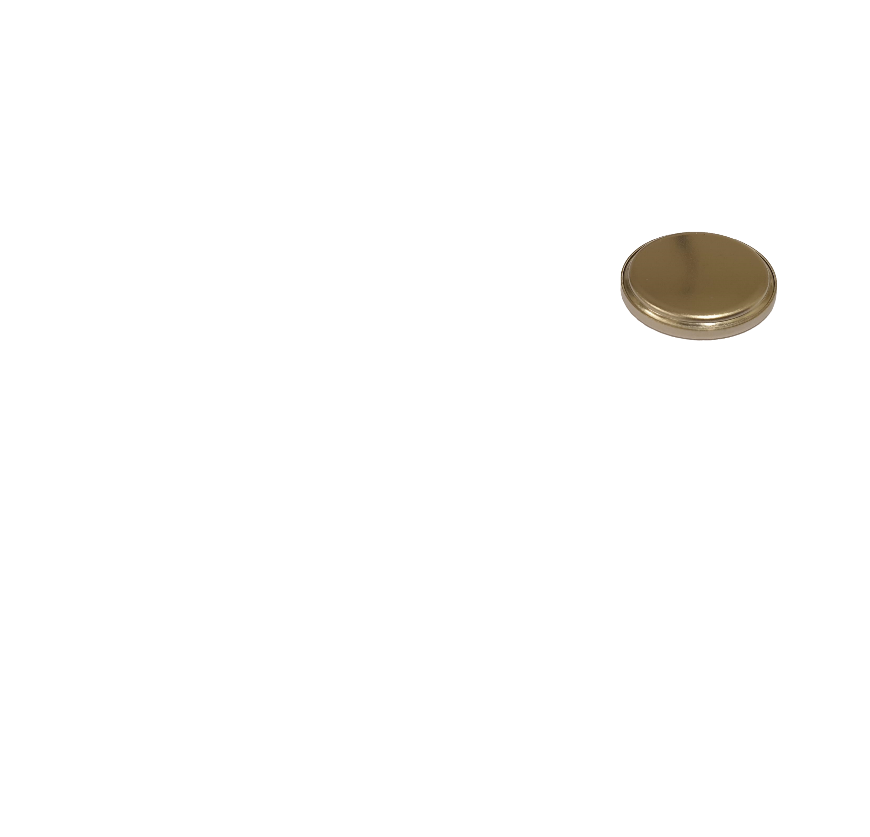
The C-cell
Cap
Spring
Spacer
Li
Separator
Cu
Gasket
Can
Notes:
Then place it in this …

Slide 44
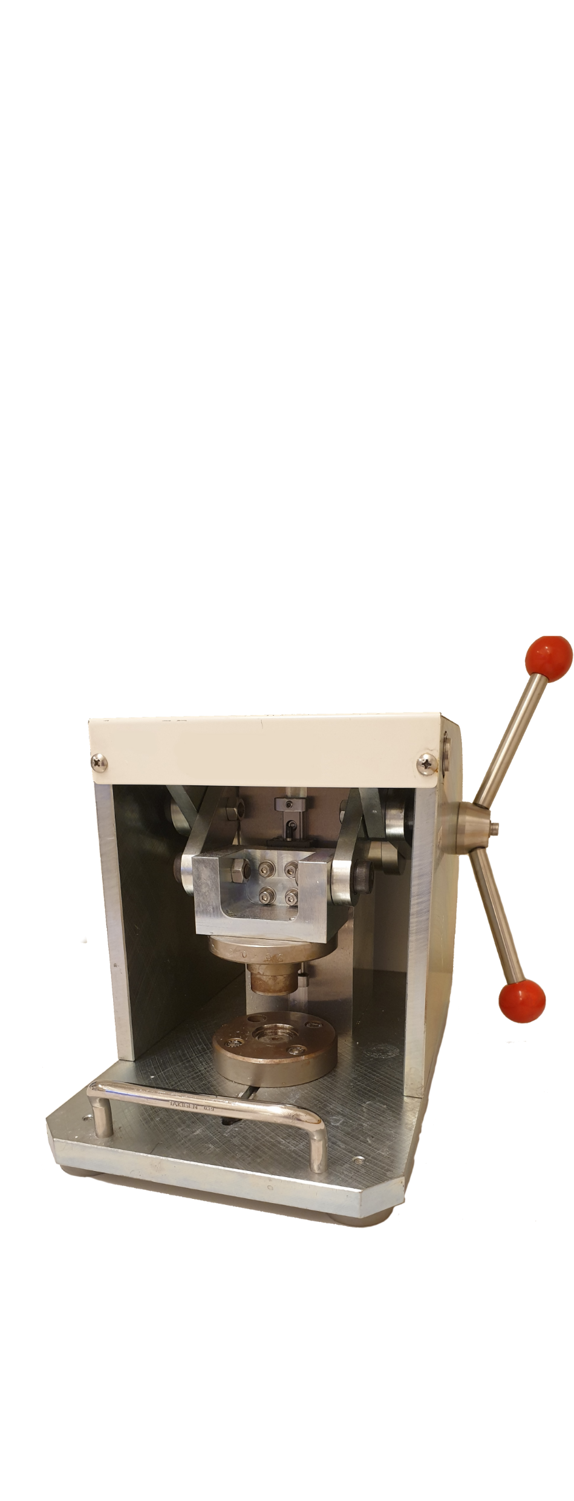
The C-cell
Cap
Spring
Spacer
Li
Separator
Cu
Gasket
Can
Notes:
And turn the handles, …

Slide 45

The C-cell
Cap
Spring
Spacer
Li
Separator
Cu
Gasket
Can
Notes:
Which closes the cell, and results in this.
Note that the spring now exerts a force in the cell, meaning there is pressure applied between the Li and Cu.
The other cell type is …

Slide 46
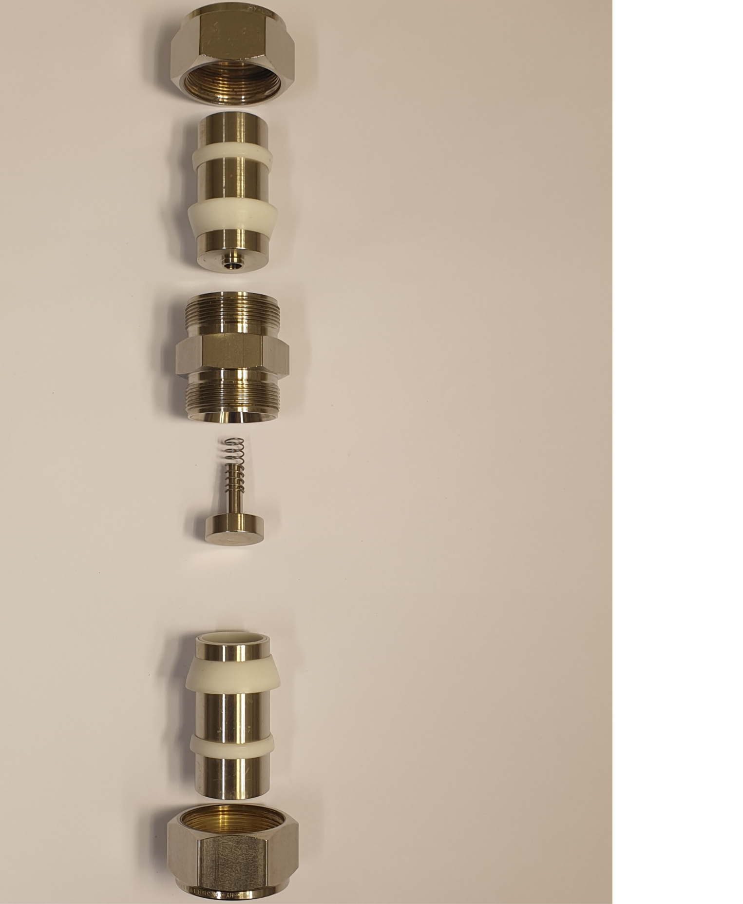
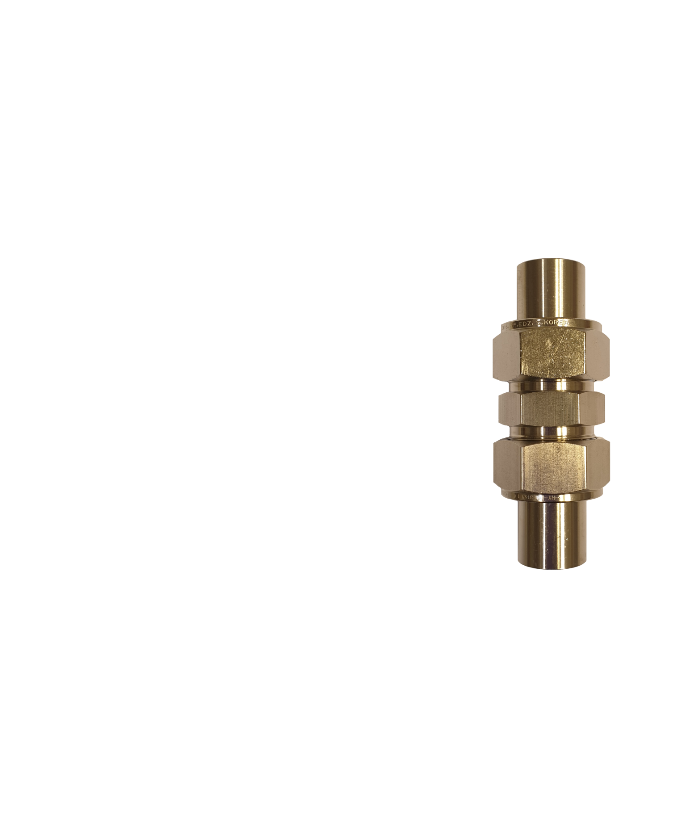

The I-cell
Nut
Metal rod
Sealing
rings
Main body
Spring
Spacer
Li
Separator
Cu

Slide 47
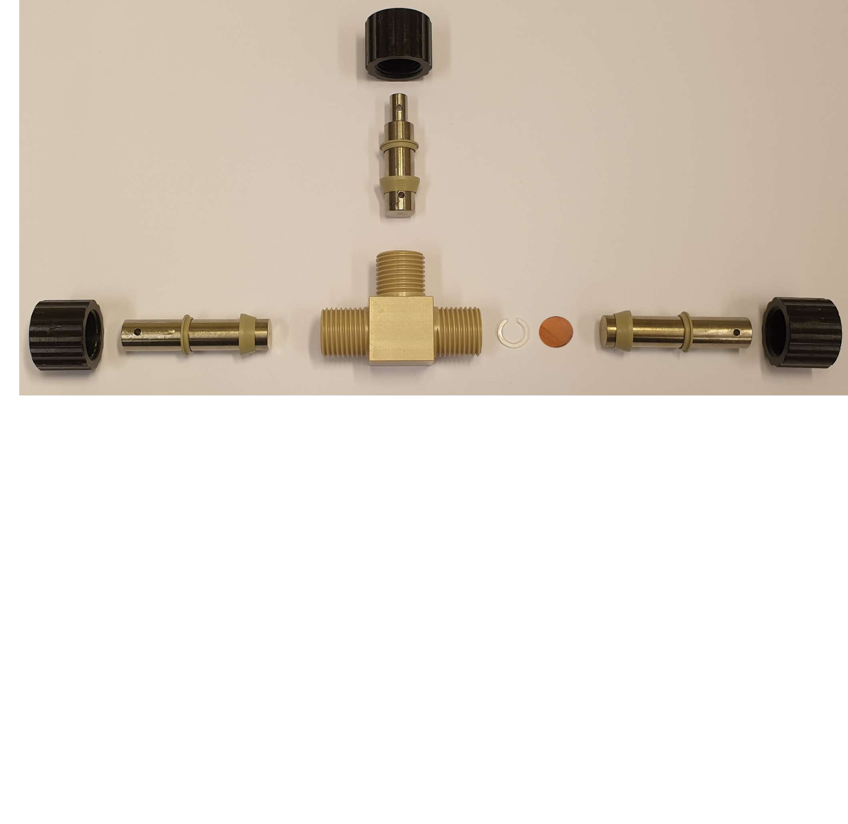

The T-cell
Nut
Metal rod
Sealing rings
Li
Main body
Spacer
Cu
Notes:
The T-cell, because it has three metal rods attached to the main body in a T-shape.
Push parts together, …

Slide 48
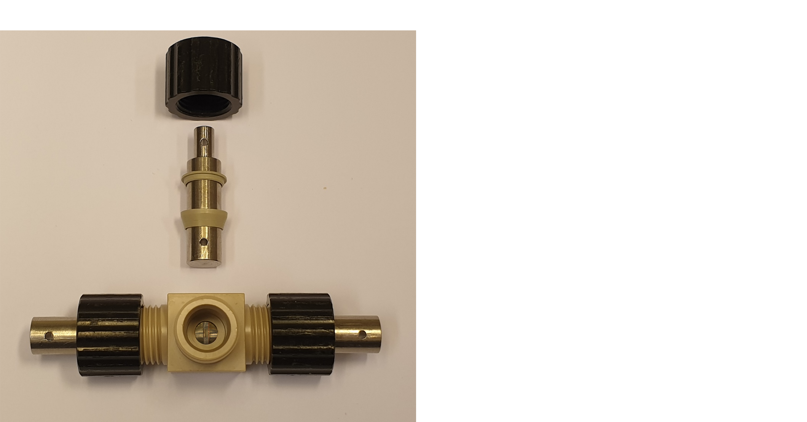
The T-cell
Notes:
Before closing the cell, electrolyte is added …

Slide 49
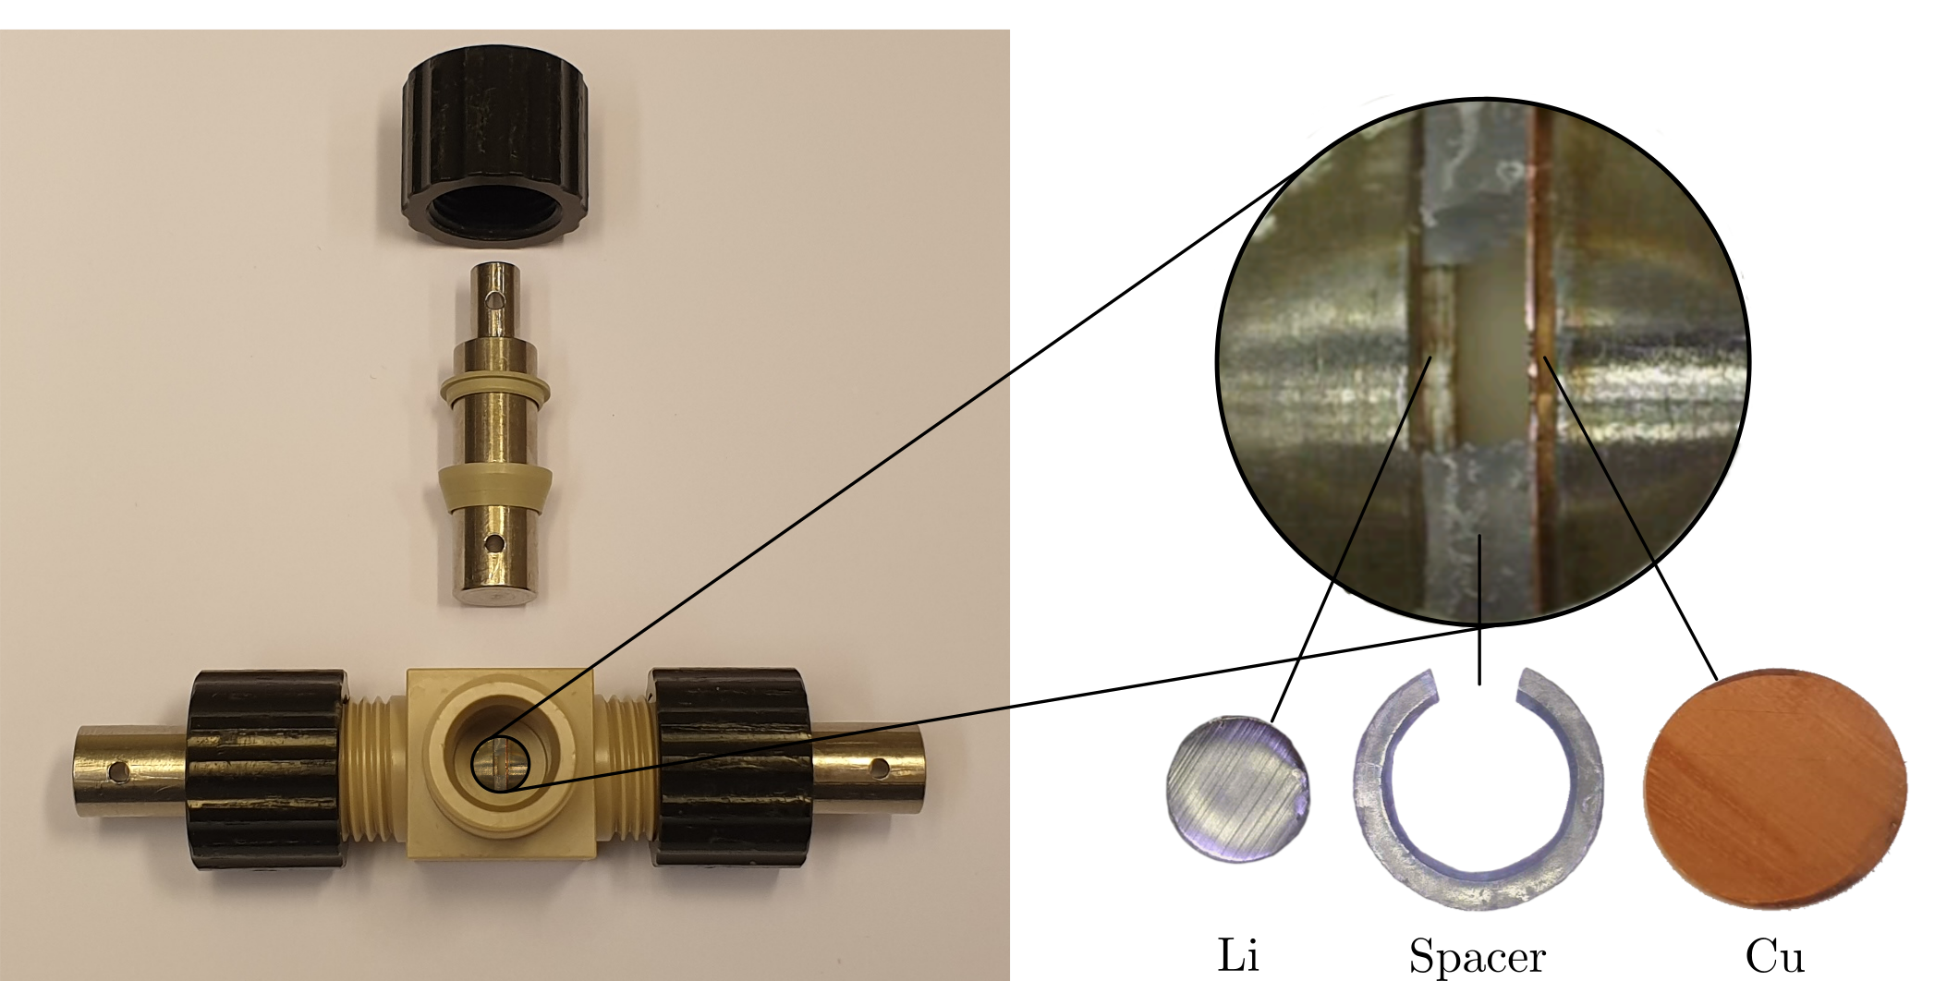
The T-cell
Notes:
Through this gap made in the spacer.
As you can see in the zoom-in, the spacer keeps a distance between the Li and Cu – so no applied pressure between them!

Slide 50
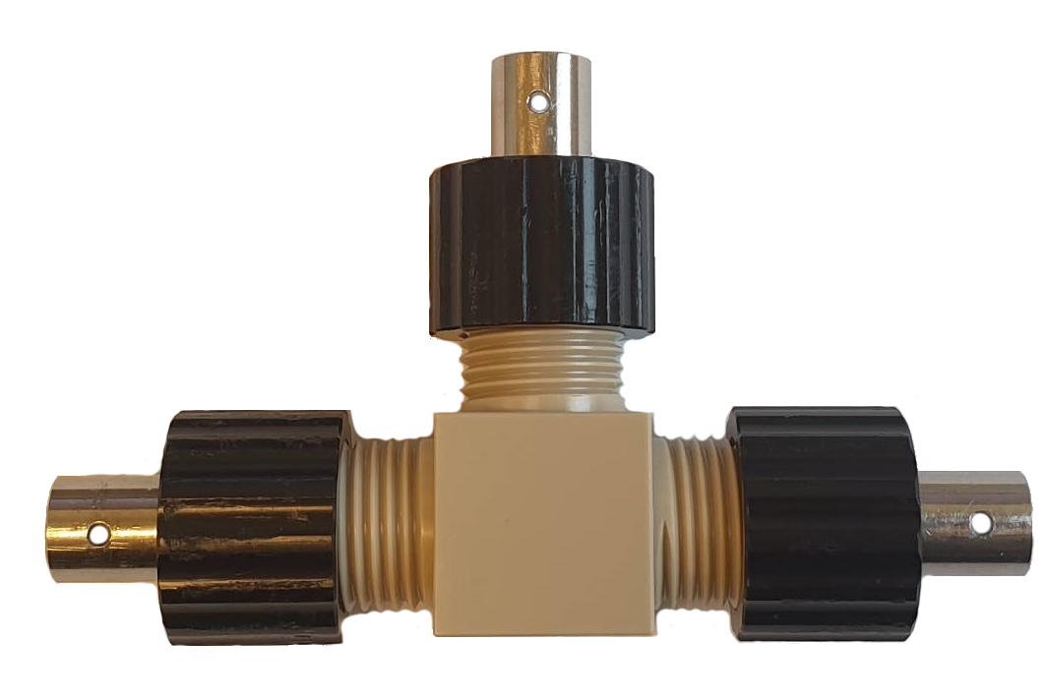
The T-cell
Notes:
The assembled cell looks like this.

Slide 51
Deposition protocol
//figure hooking up cells to the Biologic
Notes:
Now we can make some cells and to get deposition, we must cycle the cells – run a deposition program or protocol on them.
Attach cables from the electrodes, Li and Cu, to the instrument.

Slide 52
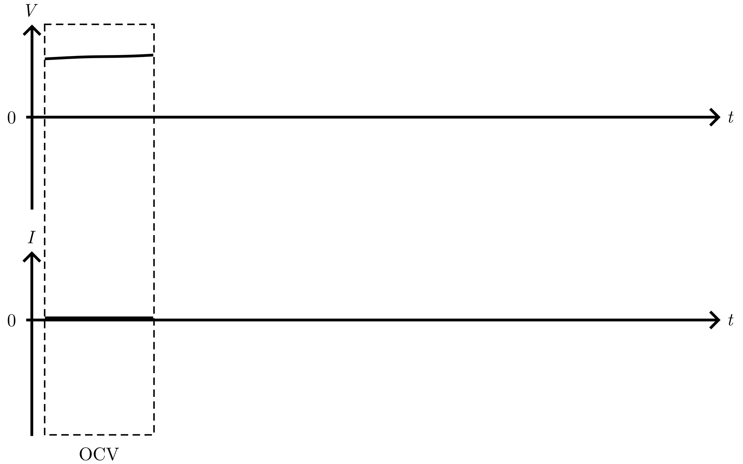
Deposition protocol
Notes:
The first part of the protocol is the OCV – we check that the cell was assembled correctly by checking its voltage.

Slide 53
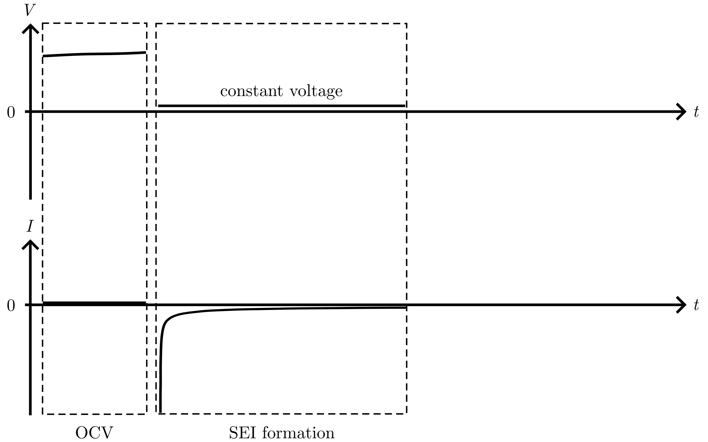
Deposition protocol
Notes:
Next is the important passivation – or SEI formation.
Here, we hold a constant and low voltage. This means that electrolyte is broken down and forms the SEI layer on the Cu.
The current, which is allowed to change freely, decreases fast and then slowly.

Slide 54
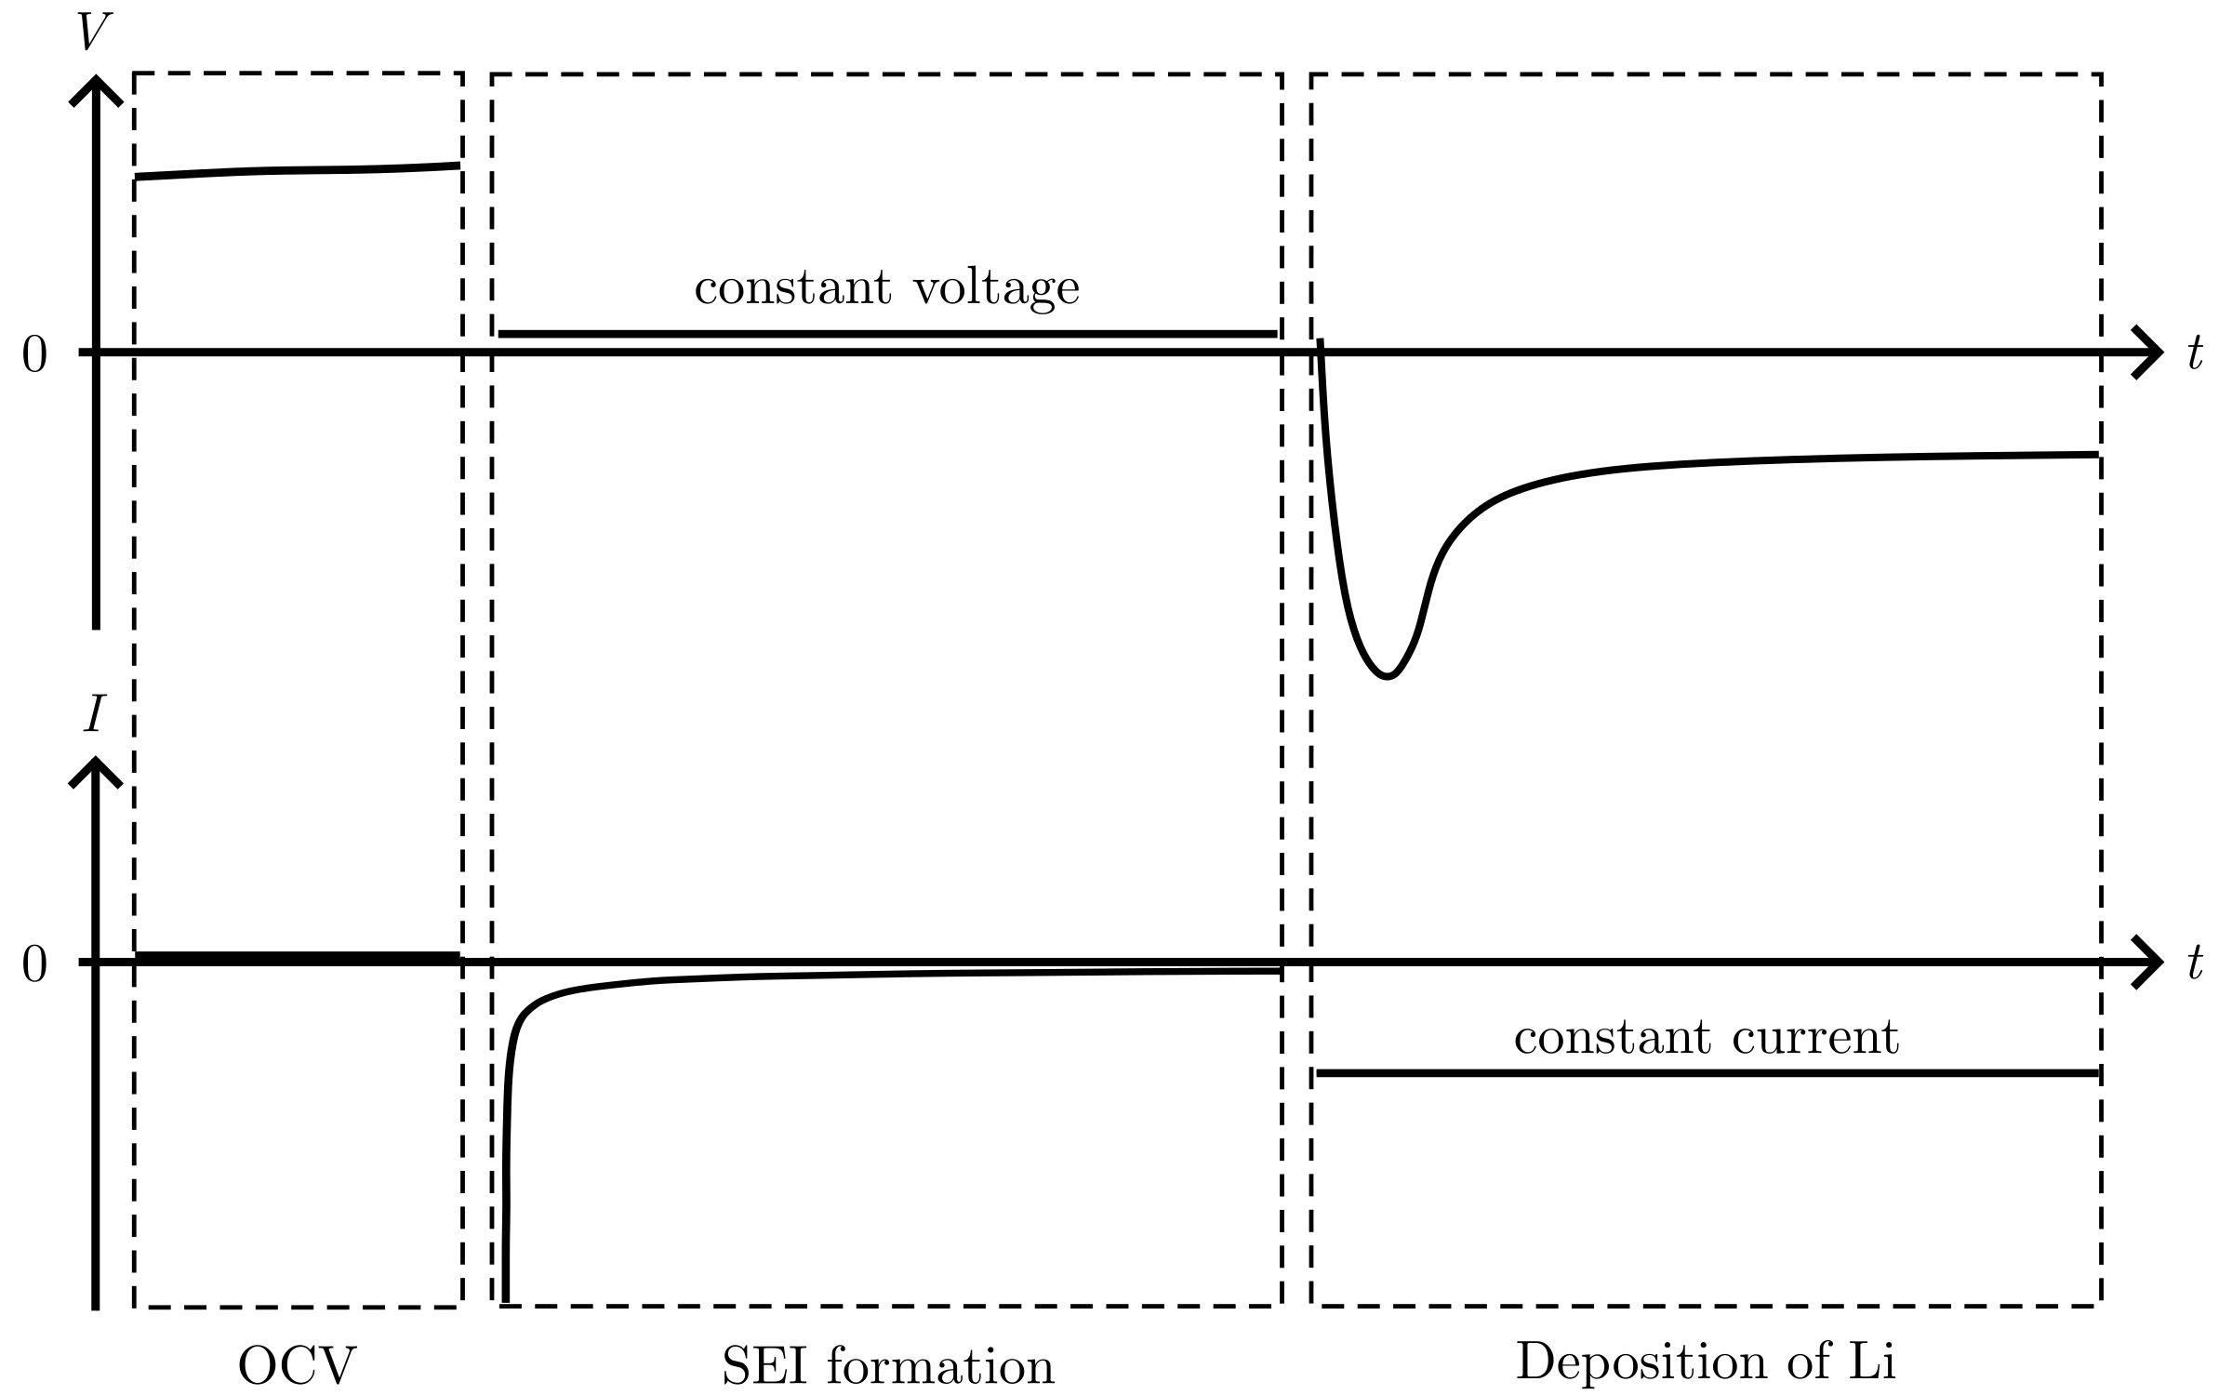
Deposition protocol
Notes:
The next step is the deposition.
A here a constant current is used, and the voltage is allowed to change freely.
This results in the deposition curve we saw earlier, with a sharp dip during the nucleation and then a flatter part during the growth.

Slide 55
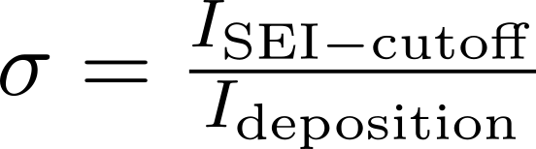

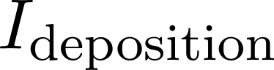
Deposition protocol:
///du är här.
Typ:
Notes:
///du är här.
Typ:
For reasons, a parameter sigma was introduced.
The protocol was set up to end the SEI formation once a low current I_SEIcutoff was reached.
Then the deposition occurred at current Ideposition.
The ratio between these, sigma, was used to try to have the same ratio of side reactions during the deposition (side reactions are all reactions besides deposition), for different deposition currents.

Slide 56
Passivation of the Cu surface
Notes:
To investigate the passivation of the Cu surface before deposition, several T-cell were cycled

Slide 57
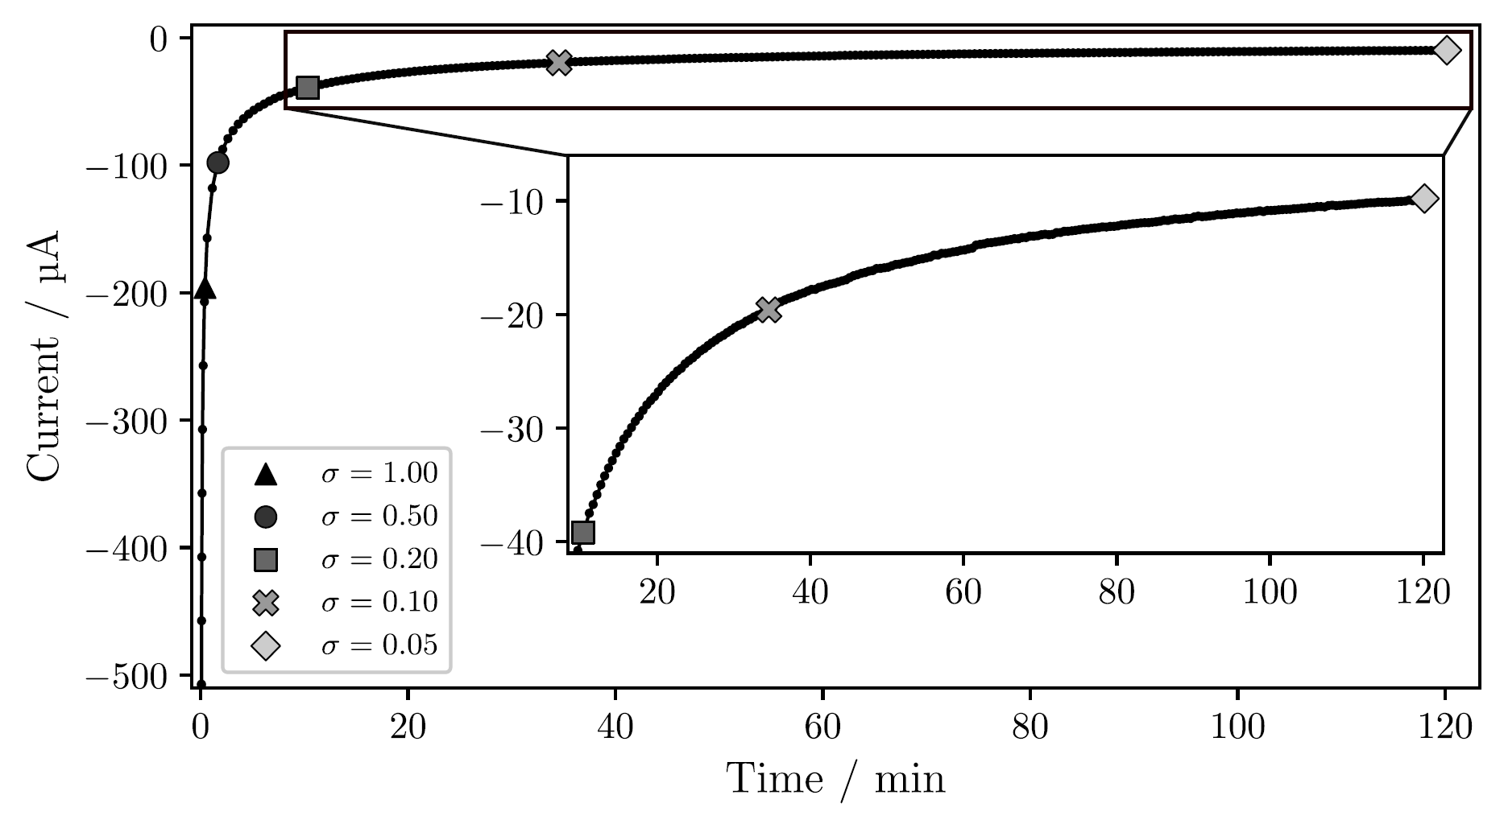
Passivation of the Cu surface
Notes:
First, the current versus time during the SEI formation by holding a constant low voltage.
T-cell, Jdeposition = 1 mAh/cm²
Time increase for lower sigma: 2 min for 0.50

Slide 58
Passivation of the Cu surface
Notes:
First, the current versus time during the SEI formation by holding a constant low voltage.
T-cell, Jdeposition = 1 mAh/cm²
Time increase for lower sigma: 2 min for 0.50, 2 hour for 0.05
After the passivation, Li was deposited at constant current

Slide 59
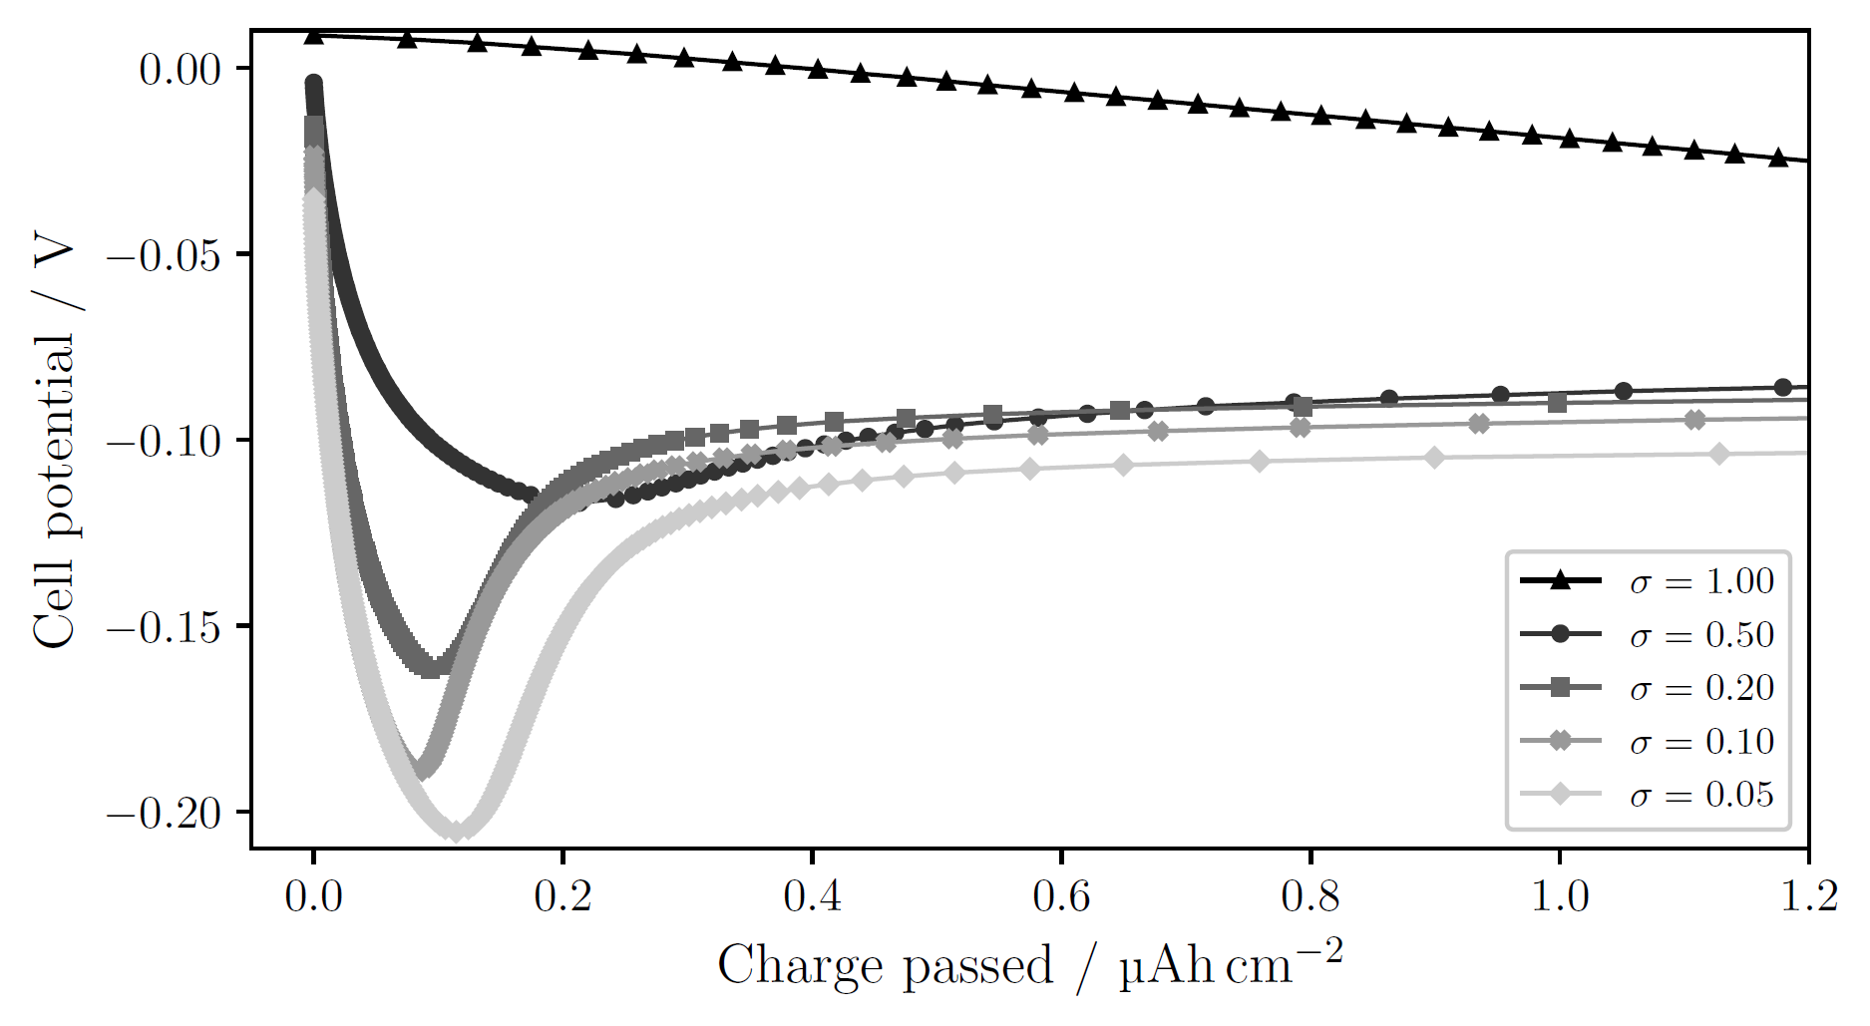
Passivation of the Cu surface
Notes:
T-cell, 1 mAh/cm²
sigma=1.00: no obvious nucleation; side reactions large enough to drive current without need for nucleation
Decreasing sigma → clearer deposition peak at higher overpotential

Slide 60
Passivation of the Cu surface
Notes:
T-cell, 1 mAh/cm²
Larger overpotential → smaller nuclei, larger N → many sites for continued growth, lowering the necessity for further nucleation. Other words: more instantaneous nucleation (all nuclei form at the start and then they only grow).
Opposed to progressive nucleation, where nuclei continue to form as other grow

Slide 61
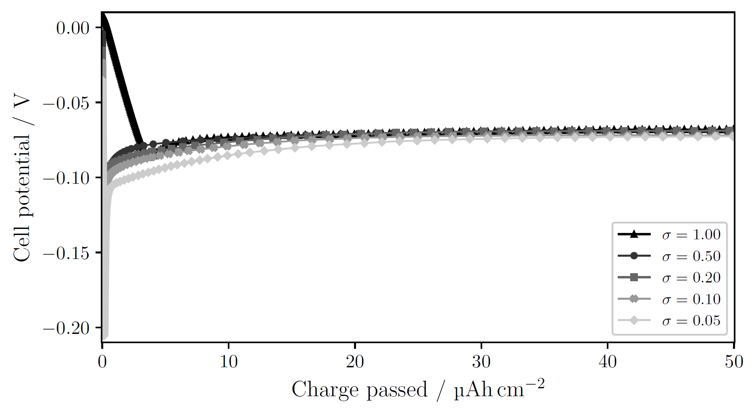
Passivation of the Cu surface larger charge passed
Notes:
T-cell, 1 mAh/cm²
sigma=1.00: no obvious nucleation; side reactions large enough to drive current without need for nucleation
Decreasing sigma → clearer deposition peak at higher overpotential
Larger overpotential → smaller nuclei, larger N → many sites for continued growth, lowering the necessity for further nucleation. Other words: more instantaneous nucleation (all nuclei form at the start and then they only grow).
Opposed to progressive nucleation, where nuclei continue to form as other grow

Slide 62
Deposition current
Notes:
Several C-cells were cycled to see the affects of the deposition current.

Slide 63
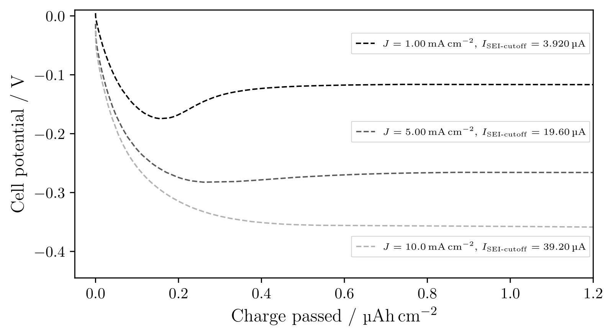
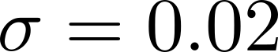
Deposition current
Notes:
Increasing current, J, results in a higher overpotential.
However, with the same sigma, the nucleation peak disappears for larger currents.
We just saw that the deposition peak is dependent on sigma, so what would happen if we passivated the surface more?

Slide 64
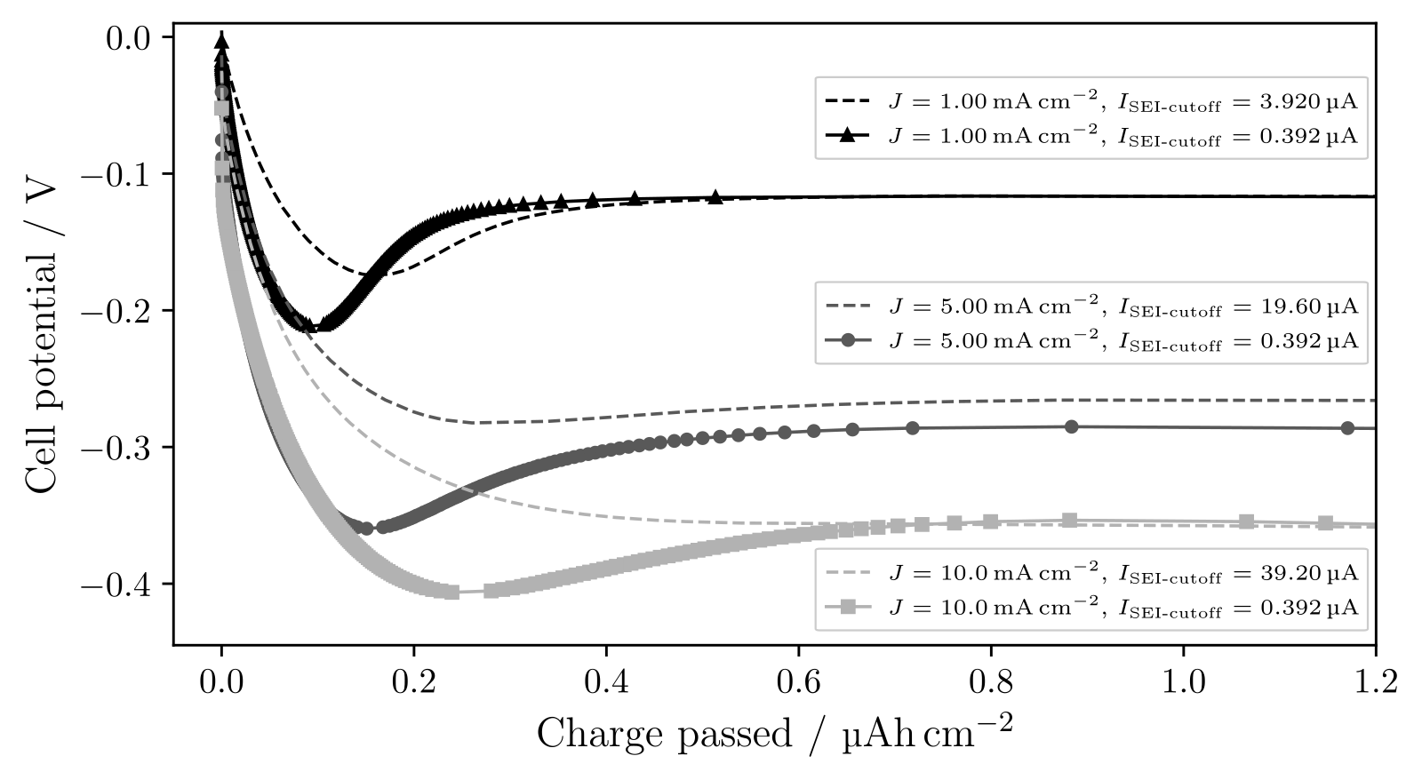
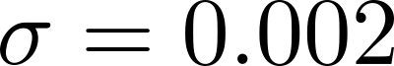
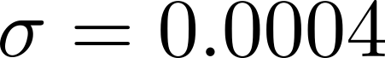

Deposition current with more passivation
Notes:
See, now the deposition peak becomes visible for larger currents.
As discussed, the sharper deposition peak indicates more instantaneous nucleation.
Thus, the absolute passivation seems to be important, I_SEI-cutoff, since we then do see the nucleation peak for all current

Slide 65

Deposition current with more passivation larger charge passed

Slide 66
Pressure effects
Notes:
To investigate the effect of pressure, a C-cell was cycled

Slide 67

Pressure effects
Notes:
Photograph Li on Cu
uneven deposition from the annulus: little to no Li in the middle, more for larger radii
Photograph: 500 muAh/cm2
SEM-images: 25 muAh/cm2 at 1mA/cm2

Slide 68

Pressure effects
Notes:
SEM-images, overlain: matched the features on the images with each other

Slide 69

Pressure effects
Notes:
Zoom in: see small Lithium nuclei

Slide 70

Pressure effects
Notes:
Moving down, slightly larger nuclei

Slide 71

Pressure effects
Notes:
Here even larger nuclei
Thus, for various radial positions we see different morphologies of Li: from small crystalline particles to larger ‘’islands’’

Slide 72
Pressure effects
2r = 1 µm
2r = 2 µm to 3 µm
2r ≥ 4 µm
Notes:
The typical size (diameter) of the nuclei goes from 1 here, 2 to 3, and then larger than 4.

Slide 73
Pressure effects
2r = 1 µm
N = 0.024 nuclei/µm²
2r = 2 µm to 3 µm
N = 0.022 nuclei/µm²
2r ≥ 4 µm
N = 0.016 nuclei/µm²
Notes:
Nuclei per area decreases while the nuclei size increases

Slide 74
Pressure effects
2r = 1 µm
N = 0.024 nuclei/µm²
2r = 2 µm to 3 µm
N = 0.022 nuclei/µm²
2r ≥ 4 µm
N = 0.016 nuclei/µm²
Notes:
These relations should be familiar

Slide 75

Pressure effects
Notes:
So, the distribution changes radially. How about the along the edge of the deposition?

Slide 76

Pressure effects
Notes:
SEM images for different angles around the edge of the deposition.
Photograph: 500 muAh/cm2
SEM-images: 50 muAh/cm2 at 1mA/cm2

Slide 77

Pressure effects
Notes:
Zoom in: see some particles, and bush-like growth

Slide 78

Pressure effects
Notes:
Here it’s mostly round particles

Slide 79

Pressure effects
Notes:
Down here overwhelmingly bush-like growth.
Yes, the deposition changes also with the angle along the deposited annulus

Slide 80


Pressure effects
Wave spring
Notes:
The reason is probably the wave spring used in the C-cell.
A study found that the wave spring induces uneven pressure in the cell, with low pressure in the middle and higher pressure for larger radii.
Exactly as the annulus of deposited Li shows.
Photograph shows that the wave spring pushed down at some points, which could explain the angular variation

Slide 81
Pressure effects
Notes:
To verify that the pressure influences the deposition, a T-cell was cycled and measured in SEM

Slide 82

Pressure effects
Notes:
SEM images as before, over the same distance the Li distribution seems more or less the same – at least much more even than in the C-cell

Slide 83

Pressure effects
Notes:
Zoom in shows that the morphology is small crystalline particles, with longer and thinner needle-like growths.
While ‘’islands’’ are not observed in the T-cell, this needle-like growth might evolve into the bush-like growth we saw in the C-cell.

Slide 84
Conclusions
Instantaneous or progressive nucleation depends on the current ratio of the side reactions and the deposition (σ).
The nuclei distribution (r and N) is influenced by the current and the degree of passivation (both changes the nucleation peak η).
Uniform pressure between the electrodes is essential to achieve uniform deposition.

Slide 85
Conclusions
1) Instantaneous or progressive nucleation depends on the current ratio of the side reactions and the deposition (σ).

Slide 86
Conclusions
2) The nuclei distribution (r and N) is influenced by the current and the degree of passivation (both changes the nucleation peak η).

Slide 87
Conclusions
3) Uniform pressure between the electrodes is essential to achieve uniform deposition.

Slide 88
Thank you for listening!

Slide 89
//Lägg in fler plots här efter på större charge och andra figurer som Isak kanske kommenterar

Slide 90
Electrochemical deposition of lithium on copper
Gottfrid Olsson
2024-05-29

